Slide 1
Mohammed and Islam—The First Woe
By
Pastor Idel Suarez Jr., Ph.D., Pg.D.
Norman College
March 13, 2023

Slide 2
Something New and Original on the 5th Trumpet
Then said he unto them, Therefore every scribe [which is] instructed unto the kingdom of heaven is like unto a man [that is] an householder, which bringeth forth out of his treasure [things] new and old.
  Matthew 13:52.

Slide 3
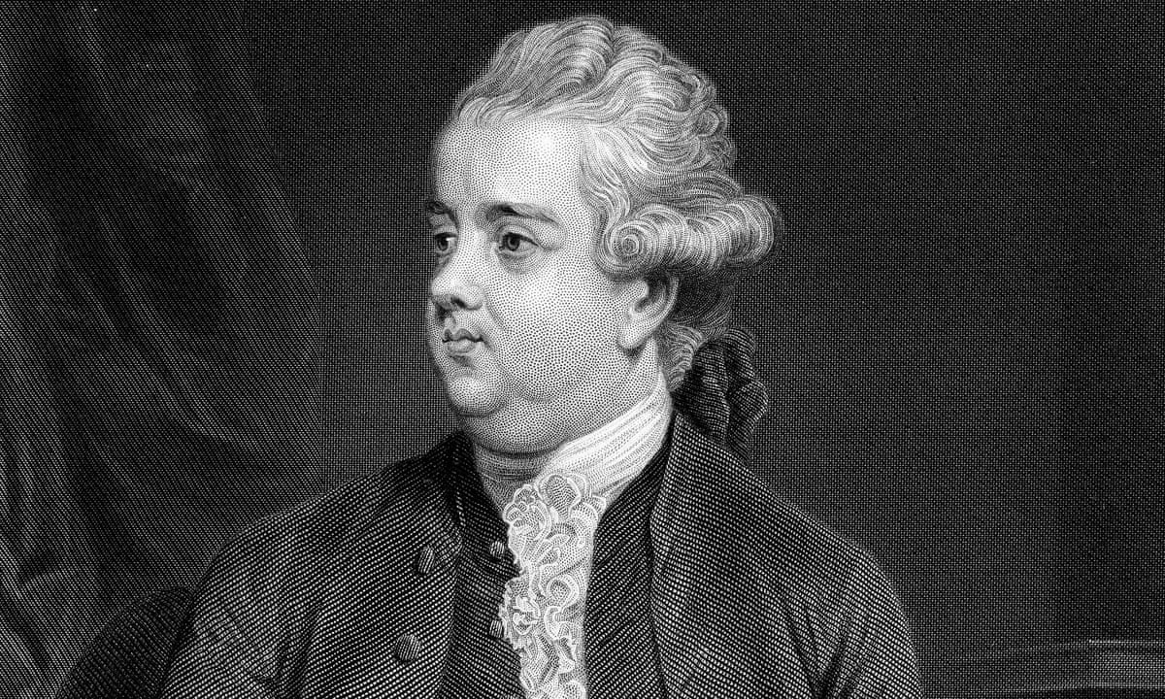
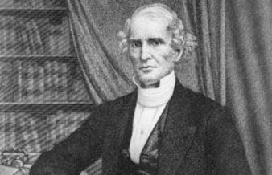
Two Authors
Edward gibbons—English Historian
Dr. Albert Barnes—Presbyterian

Slide 4
Satan Sends the Woes but God Allows it
Therefore rejoice, [ye] heavens, and ye that dwell in them. Woe to the inhabiters of the earth and of the sea! for the devil is come down unto you, having great wrath, because he knoweth that he hath but a short time.
  Revelation 12:12.

Slide 5
An Overview of the Three Woes
And I beheld, and heard an angel flying through the midst of heaven, saying with a loud voice, Woe, woe, woe, to the inhabiters of the earth by reason of the other voices of the trumpet of the three angels, which are yet to sound!
  Revelation 8:13.

Slide 6
New look at the 3 Woes

Slide 7
Satan’s Three Attacks on Redemption
First Woe
Muhammed I /Caliphs & Islam/
Othman/Turks
Second Woe
Muhammed II /Suleiman & Turks
French Revolution
Third Woe
American Rome
Attacking the Heavenly Sanctuary and its Services; The Investigative Judgment and the Spirit of Prophecy
Attacking Godhead—Christ’ Divinity and Spirit’s Personhood
Attacking the Bible—God’s Word and its validity and reliability
The World Wars

Slide 8
The Attack on the Godhead
Revelation 9:1,2
Interpretation
9:1 And the fifth angel sounded, and I saw a star fall from heaven unto the earth: and to him was given the key of the bottomless pit.
9:2 And he opened the bottomless pit; and there arose a smoke out of the pit, as the smoke of a great furnace; and the sun and the air were darkened by reason of the smoke of the pit.
The Star is Mohammed 570-632 AD the prophet of Islam (Submission); Revelation 12:4.
Key is the Koran—the false gospel; 2 Cor. 11:14-15; Luke 11:15; Matthew 16:19
Bottomless Pit—Wilderness/Arabian desert, a desolate place. Revelation 20:3.
Smoke—Recited Prayers; Psalms 141:2; Matthew 6:5-7.

Slide 9
The Attack on Divinity—the Godhead
The Sun—Jesus Christ
The Air—The Spirit of God
But unto you that fear my name shall the Sun of righteousness arise with healing in his wings; and ye shall go forth, and grow up as calves of the stall. Malachi 4:2.
I Jesus have sent mine angel to testify unto you these things in the churches. I am the root and the offspring of David, [and] the bright and morning star. Revelation 22:16.
The wind bloweth where it listeth, and thou hearest the sound thereof, but canst not tell whence it cometh, and whither it goeth: so is every one that is born of the Spirit. John 3:8.
And when he had said this, he breathed on [them], and saith unto them, Receive ye the Holy Ghost: John 20:22.

Slide 10
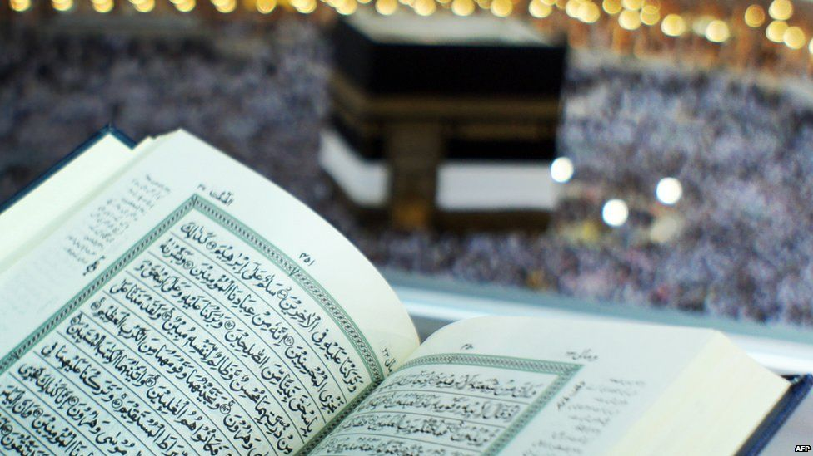
Al Qur’an

Slide 11
Koran speaks out
Denies the Divinity of chirst
Denies the Crucifixion of Jesus
Surely they disbelieve those who say: “Allah is the Messiah son of Mary.” The Messiah himself said: “O Children of Israel! Worship Allah, my Lord and your Lord. Whoever joins other gods with Allah, for him Allah has forbidden paradise. His abode is the Fire. The evildoers shall have no helpers.”
  Surah 5.72; also Surah 5:17
That they said (in boast), ‘We killed Christ Jesus the son of Mary, the Apostle of God’; but they killed him not, nor crucified him, but so it was made to appear to them, and those who differ therein are full of doubts, with no (certain) knowledge…
  Surah 4:157, 158.

Slide 12
Mohammedanism denies Jesus’ Divinity
The Saviour has said, "He that believeth on the Son hath everlasting life: and he that believeth not the Son shall not see life… He says again, "And this is life eternal, that they might know thee, the only true God, and Jesus Christ whom thou hast sent."
Mohammedanism has its converts in many lands, and its advocates deny the divinity of Christ. Shall this faith be propagated, and the advocates of truth fail to manifest intense zeal to overthrow the error, and teach men of the pre-existence of the only Saviour of the world? O how we need men who will search and believe the word of God, who will present Jesus to the world in his divine and human nature, declaring with power and in demonstration of the Spirit, that "there is none other name under heaven given among men, whereby we must be saved."
  Home Missionary, September 1, 1892 par. 4

Slide 13
The Locusts-Scorpions—the Arabs
And there came out of the smoke locusts upon the earth: and unto them was given power, as the scorpions of the earth have power.
  Revelation 9:3
Locusts/Scorpions—creatures of the desert are the Arabs of the Middle East.
Power—authority
And [so] it was, when Israel had sown, that the Midianites came up, and the Amalekites, and the children of the east, even they came up against them;
And they encamped against them, and destroyed the increase of the earth, till thou come unto Gaza, and left no sustenance for Israel, neither sheep, nor ox, nor ass.
For they came up with their cattle and their tents, and they came as grasshoppers for multitude; [for] both they and their camels were without number: and they entered into the land to destroy it. Judges 6:3, 5.

Slide 14
Abu bakr’s words—the First caliph
Be just, valiant; die rather than yield; be merciful; slay neither old men, nor women, nor children. Destroy no fruit trees, grain, or cattle. Keep your word, even to your enemies. Molest not those religious persons who live retired from the world, but compel the ret of mankind to become Moslems or pay tribute. If they refuse these term, slay them. [632 A.D.]
  Will Durant, Mohammed, The Age of Faith, 188.
And it was commanded them that they should not hurt the grass of the earth, neither any green thing, neither any tree; but only those men which have not the seal of God in their foreheads.
  Revelation 9:4.

Slide 15
The five months

Slide 16
The Five Months—Mentioned Two Times are two different events and dates
Revelation 9:5--Saracens
Revelation 9:10--Turks
And to them it was given that they should not kill them, but that they should be tormented five months: and their torment [was] as the torment of a scorpion, when he striketh a man.
And they had tails like unto scorpions, and there were stings in their tails: and their power [was] to hurt men five months.

Slide 17
Five Months are 150 years of Islam Expansion
570-732 AD
Mohammed to Charles Martel
612-762 AD
Mohammed to Baghdad

Slide 18
Brief Biography of Mohammed
570 Mohammed is born in Mecca; His father dies
576 Mohammed’s mother dies; is adopted by His paternal Uncle Abu Talib of the Quraysh Tribe
582 Mohammed travels to Syria and meets Bahira—an Arian Monk—who foretells that Mohammed now 12 years of age will be a prophet
595 Mohammed marries Khadija (15 years older) and only one daughter survives Fatima
610 Mohammed has his first vision in a cave at 40 years of age; pseudo Angel Gabriel appears to him
612 Mohammed has his second vision and starts to preach
619 Mohammed’s wife died; His uncle died. Mohammed would eventually marry over 11 wives including his favorite Aisha of 7 years old
622 He escapes to Medina the hijra (exodus) and the start of the Islamic Calendar
630 His return with 10,000 soldiers to Mecca; Destroys 360 idols at the Kaaba in Mecca
632 He returns to Medina and dies on June 8 from being poisoned at 62 years of age.

Slide 19
Ali’s description of Mohammed
Muhammed was “of middle stature, neither tall or short. His complexion was rosy white, his eyes black; his hair, thick and brilliant, and beautiful, fell to his shoulders. His profuse beard fell to his breast…”
  Will Durant, Mohammed, The Age of Faith, 162-163.

Slide 20
Two Dates for the 150 years
582 to 732 AD
612 to 762 AD
582 Mohammed meets the Arain Monk Bahira who predicts that Mohammed will become a prophet. He advises Mohammed’s uncle to protect him from Jews and Byzantine Christians
732 Charles Martel defeats the Muslim advance from Spain into France at the Battle of Tours—Europe was saved from Islam
612 Mohammed receives his second vision and starts to preach publicly in Mecca
762 al-Mansur orders the construction of Baghdad (in modern Iran) as the new capital of Islam believers between Tigris and Euphrates Rivers—The Islam conquest looses its steam

Slide 21
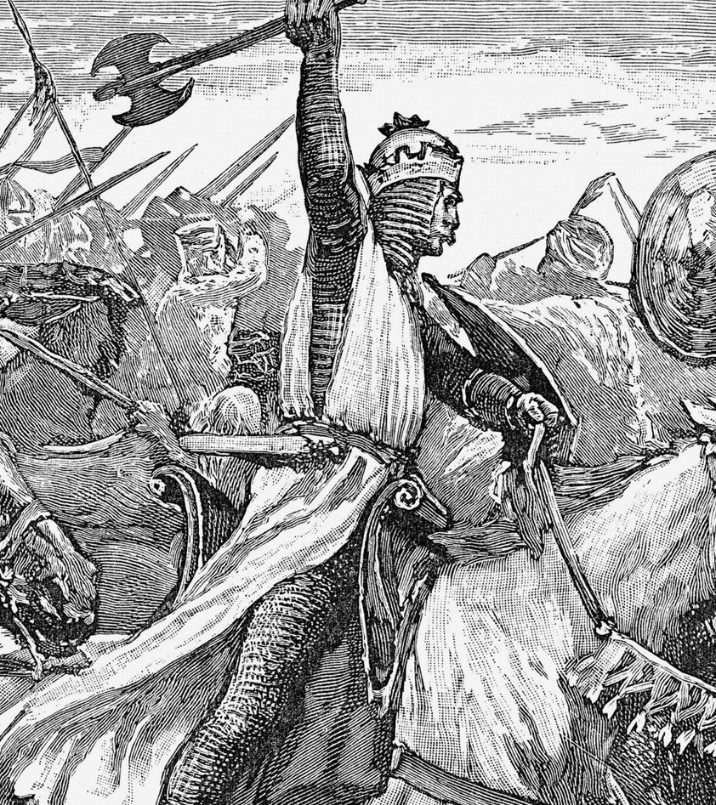
The Battle of Tours
Fought on October 10, 732
Charles Martel, King of the Franks with 20-25,000 soldiers and had 1,000-1,500 dead
vs.
Abd al-Rahman al-Ghafiq, al Andalus governor—died and >12,000 dead (army strength 20,000 to 80,000)

Slide 22
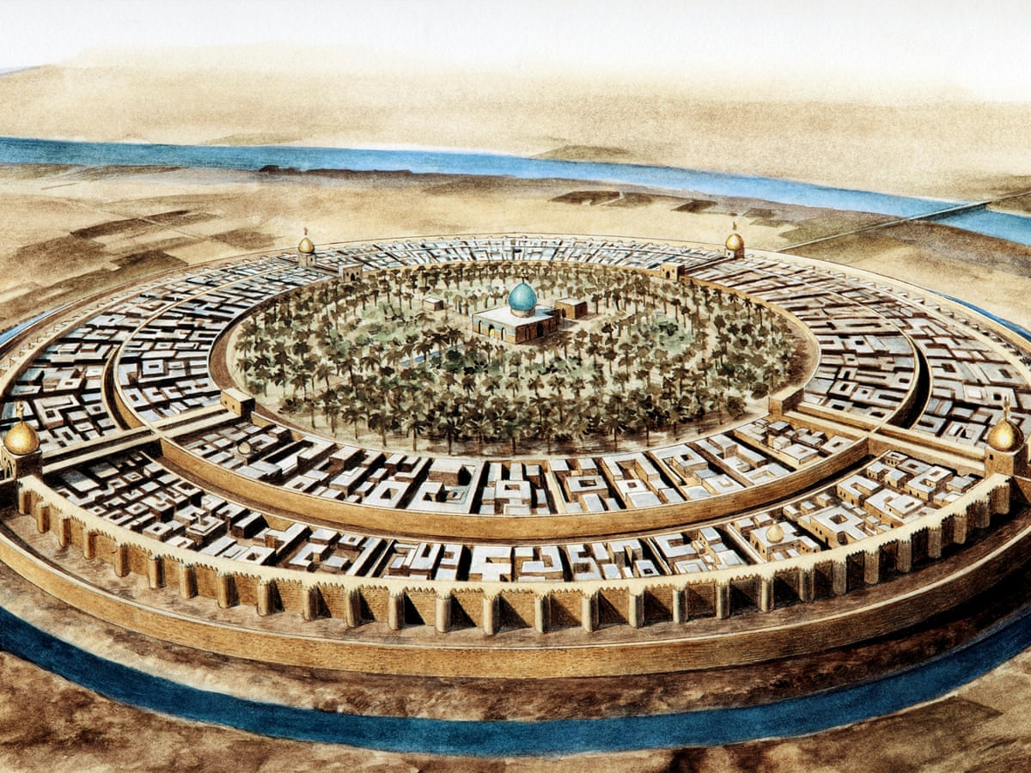
Baghdad—the Round City
Founded in 762
By
Al-Mansur
Became the new cultural center of Islam
Appealed to the newly converted Persians

Slide 23
The Traditional 150 years
1299 AD—July 27, Othman first invaded the territory of Nicomedia
  Edward Gibbon, The Decline and Fall of the Roman Empire, vol vi., chapter 64, 236.
1449 AD—July 27, (Deacozes) Constantine XI accepted the Byzantine crown only with the permission of the Ottoman Sultan Murad II (Amurath) (ruled 1421-1444, 1445-1451 A.D.)
1840—August 11, Ottoman Empire (Turkey) yields to the European powers
And they had tails like unto scorpions, and there were stings in their tails: and their power [was] to hurt men five months.
  Revelation 9:10.
5 months=150 years from 1299 to 1449

Slide 24
Spirit of Prophecy Confirmation
In the year 1840 another remarkable fulfillment of prophecy excited widespread interest. Two years before, Josiah Litch, one of the leading ministers preaching the second advent, published an exposition of Revelation 9, predicting the fall of the Ottoman Empire. According to his calculations, this power was to be overthrown "in A.D. 1840, sometime in the month of August;" and only a few days previous to its accomplishment he wrote:
"Allowing the first period, 150 years, to have been exactly fulfilled before Deacozes ascended the throne by permission of the Turks, and that the 391 years, fifteen days, commenced at the close of the first period, it will end on the 11th of August, 1840, when the Ottoman power in Constantinople may be expected to be broken. And this, I believe, will be found to be the case.“
  --Josiah Litch, in Signs of the Times, and Expositor of Prophecy, Aug. 1, 1840. {GC 334.4}
At the very time specified, Turkey, through her ambassadors, accepted the protection of the allied powers of Europe, and thus placed herself under the control of Christian nations. The event exactly fulfilled the prediction….
  {GC 335.1}

Slide 25
Apollyon
And they had a king over them, [which is] the angel of the bottomless pit, whose name in the Hebrew tongue [is] Abaddon, but in the Greek tongue hath [his] name Apollyon.
  Revelation 9:11
Apollyon= Osman—the caliph and commander of the Turks who establishes the Ottoman Empire
Apollyon means destroyer and Osman means bone breaker. It is the name of the large royal vulture among the Arabs.

Slide 26

The Day Star Rise in Your Heart
We have also a more sure word of prophecy; whereunto ye do well that ye take heed, as unto a light that shineth in a dark place, until the day dawn, and the day star arise in your hearts:

