Slide 1
The Revelation of Jesus Christ

Slide 3
Jesus Christ :The Alpha and The Omega

Slide 4
The Title of the Book…

Slide 5
Translators’ Error…
The Book is a “Revelation of Jesus Christ”
It is NOT a “Revelation of St. John the Divine”
CHRIST is the Revelator, not John.
John is Christ’s “Penman” who was ordered by Christ: “What thou seest, write in a book, and send it (the book) unto the seven churches…”
(Rev:1:1,10,11)

Slide 6
Writer, Time and Place
WRITER: John the beloved apostle. TIME: Probably A. D. 96 or 97. PLACE: The visions were given on the barren, rocky island of Patmos, which the Roman Empire used as a place of banishment.

Slide 7
The Character of The Book…
It is a “REVELATION”:
- Something revealed or made known.
It is NOT a hidden book or Concealed Book to God’s people
GOD wants us to KNOW and Understand This Book…our Eternal Salvation depends on it.
(Duet:29:29)

Slide 8
The Character of The Book…
" The great prophecies of the Old Testament are supplemented and illuminated by the Revelation. Here the symbols of Isaiah, Ezekiel, Daniel, and Zechariah live and move again before our eyes. Here the great typical figures of the Old Testament find place in greatly enlarged antitypes. Former prophecies and visions of the sufferings, the triumphs, and the glory of Christ, with the fruitage of all the seed-sowing of the centuries, are more graphically, clearly, and gloriously portrayed in the Revelation of Jesus our Lord.

Slide 9
The Object/Purpose of the Book…
This Book of Prophecy was given to Reveal Coming Events to God’s servants.
The Book also Reveals PAST events in the great War between Christ and Satan

Slide 10
.The Object/Purpose of the Book…
“To Show unto His servants things which must shortly come to pass.”- {Rev:1:1}
Who are God’s Servants?
- Those love and fear him.
The Secrets revealed in the Book is for God’s Children in all time, and has specific application to specific period(s) of the history of God’s Church.

Slide 11
The Divine Method of Revelation…

Slide 12
From Angel Gabriel to Prophet John…

Slide 13
Gabriel Is the Angel of Prophecy
He was the one whom God sent to Reveal the Prophecies to Daniel (Dan 8:15-18; 9:20-23; 10:7-14,18-21); he was sent to Virgin Mary; to Zacharias(John the Baptist’s father)-
{Luke 1:1-37}
He strengthened Jesus in Gethsemane, and was the angel who came to call Jesus From the Tomb: (Luke 22:41-43; Matt:28:1-7)

Slide 14
God pronounces Blessings on those who Read, Hear, and Keep the words of this Book
Rev:1:3

Slide 15
Blessings on those who Read, Hear, and Keep the words of this Book
What incentive is urged? Verse 3, last clause.
³ Blessed is he that readeth, and they that hear the words of this prophecy, and keep those things which are written therein: for the time is at hand.
"The time is at hand." The developments of early Christianity were already beginning. The power of the gospel had reached all lands. The early stages of the great apostasy were present. The time was at hand, for the great revelation was then unfolding. How infinitely more important it is to us to give heed now, when "the time is at hand" that the great drama is about to close!

Slide 16
The Source of Blessings…
(Rev:1:4-6)

Slide 17
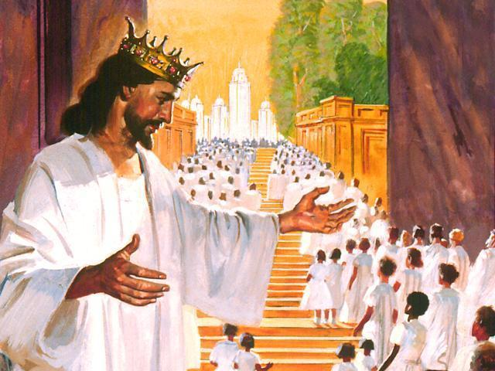
… And From Jesus Christ
The Faithful Witness
The First begotten of the dead
the Prince of the kings of the earth
Him that Loved us, and washed us from our sins in His own blood
Who “hath made us kings and priests unto GOD and His Father

Slide 18
Who are the Seven Spirits of God?
God does NOT have 7 literal Spirits. Jesus, referring to the Holy Spirit uses the SINGULAR pronoun (s): “HE”, and “HIM” , and NEVER refers to the Holy Spirit of God (The Comforter) – as “THEY”. (See John 14:16-17,26; 16:7-813-15).
The “Seven Spirits of God” – refers to the Holy Spirit of God = the Holy Ghost.
The is only ONE Holy Ghost, ONE God the Father, and ONE Jesus Christ – the Son of God.
“For there are Three that bare record in heaven, the Father, the Word, and the Holy Ghost: and these three are one.” – (1John 5:7).
Seven (7) is a perfect and sacred number, and symbolises the fullness and perfection of the Holy Spirit’s nature,gifts and operations.

Slide 20
The Lamb of God

Slide 21
The
Dedication

Slide 23
The Book is Dedicated to the…
(Rev: 1:4)

Slide 26
The First- Begotten of the Dead
The Actual resurrection of Christ was NOT the chronologically FIRST resurrection that occurred; BUT “In the purpose of God He was the first in point of time as well as importance” – and all who were released from the grave BEFORE and AFTER Christ’s death and Resurrection – were resurrected by virtue of His victory atoning sacrifice & His Glorious Resurrection

Slide 27
Behold He cometh with Clouds
Rev:1:7

Slide 28
“They Also Which Pierced Him”
Daniel 12:1-2
(Rev 1:7)
Mark:14:60-65

Slide 29
Christ does Not sit on His own Throne presently – But on His Father’s Throne
Rev:3:21
Heb:1:13
BUT the time is coming soon when HE shall give up His Father’s Throne and come to Reign on His Own Throne :
- (1Cort. 15: 24 – 28)

Slide 30
John Beholds the Glorious LORD!

Slide 32
Jesus walking amidst the 7 Candlesticks or Lamp Stands

Slide 33
Correct Interpretation…
The 7 Stars = The Angels of the 7 Churches
The “Angels” are the Leaders of the 7 churches
The 7 Candlestick = the 7 Churches

Slide 34
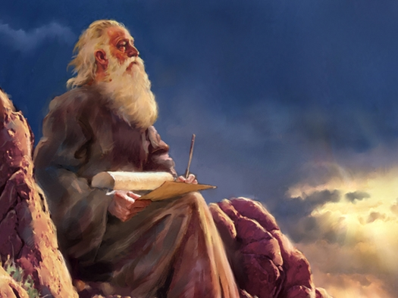
Church Leaders/Ministers are
Called by God to be Faithful Watchmen (like angels) over His Flock.
Duties of a Church Leader?
The Love Christ’s sheep
To Preach, Teach, Live, and
Defend the Truth of the
Scriptures
To warn the people of Sins
and from Sins
To Guard and cherish the
Flock
To Carry the burdens of the
Flock upon his heart
To intercede for the flock
before God in prayers
To be a godly example of a
servant of Christ.
They are to be Servants God’s flock and not Lords over God’s heritage (Church)
- {See: 1Tim:4:1- 3;Ezek:3:17-21; 1Tim 4: 11-12,15-16}

Slide 36
“The Word of God is quick, and powerful, and sharper than any two-edged sword, piercing even to the dividing asunder of soul and spirit, and of the joints and marrow, and is a discerner of the thoughts and intents of the heart.” – (Heb: 4:12)
“And take the helmet of salvation, and
the sword of the Spirit, which is the
word of God” – (Ephes:6:17)

