Slide 1
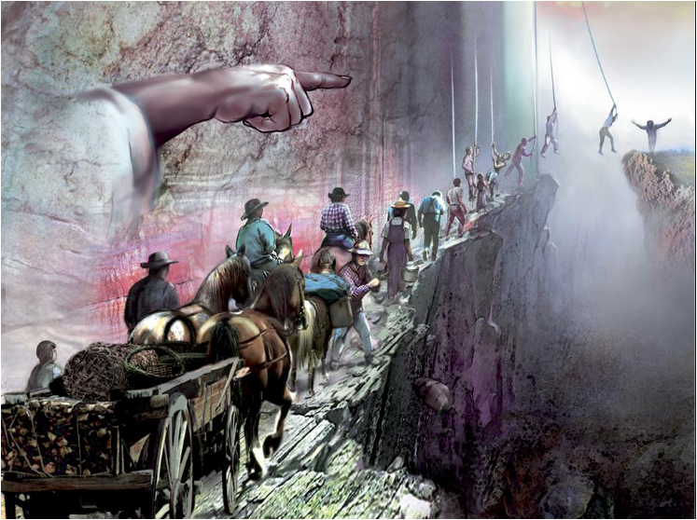
MAKE PLAIN
THE PLAN OF SALVATION
PART 1
TRANSFORMATIONS
OF THE TWELVE
ISRAEL’S TRIBES
“THE TRUTH AS IT IS” –
INVESTIGATING STUDY PROGRAM
CHRIST IS COMING SOON – ARE WE READY?

Slide 2
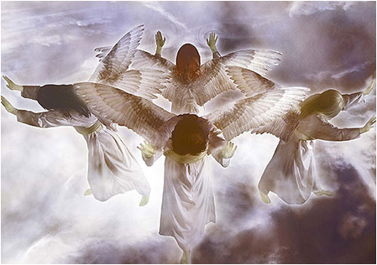
THE CHARACTER OF THE 144000

Slide 3
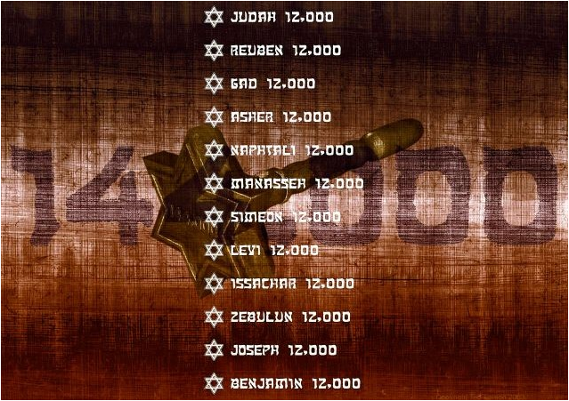
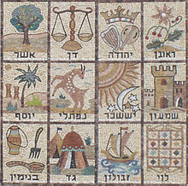
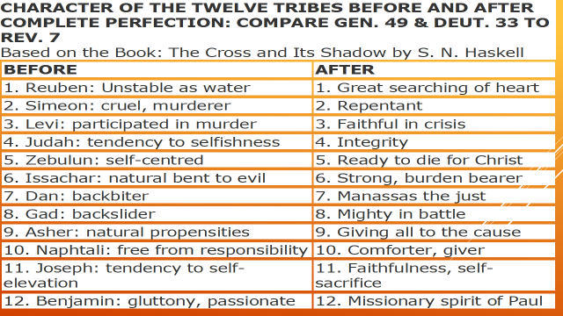
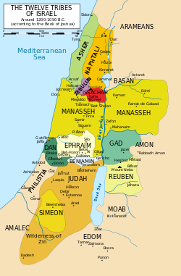
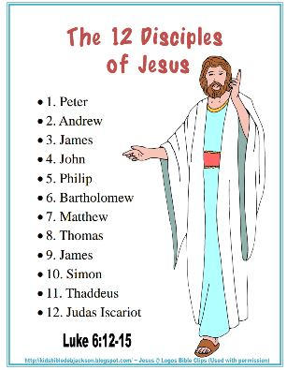
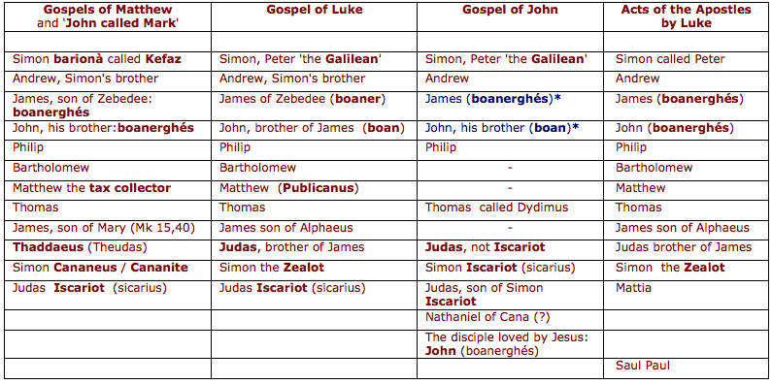
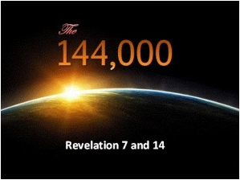

Slide 4
ONE HUNDRED AND FORTY-FOUR THOUSAND
OF ALL THE TRIBES OF THE CHILDREN OF ISRAEL
Revelation 7:4-8
⁴ AND I HEARD THE NUMBER OF THOSE WHO WERE SEALED. ONE HUNDRED AND FORTY-FOUR THOUSAND OF ALL THE TRIBES OF THE CHILDREN OF ISRAEL WERE SEALED:
1. of the tribe of JUDAH twelve thousand were sealed; 2. of the tribe of REUBEN twelve thousand were sealed; 3. of the tribe of GAD twelve thousand were sealed; 4. of the tribe of ASHER twelve thousand were sealed; 5. of the tribe of NAPHTALI twelve thousand were sealed; 6. of the tribe of MANASSEH twelve thousand were sealed; 7. of the tribe of SIMEON twelve thousand were sealed; 8. of the tribe of LEVI twelve thousand were sealed; 9. of the tribe of ISSACHAR twelve thousand were sealed;
10. of the tribe of ZEBULUN twelve thousand were sealed; 11. of the tribe of JOSEPH twelve thousand were sealed; 12. of the tribe of BENJAMIN twelve thousand were sealed.

Slide 5
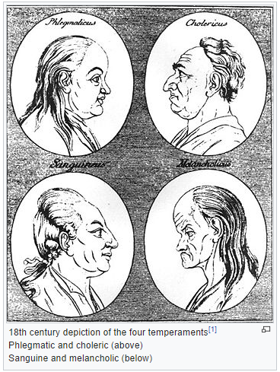
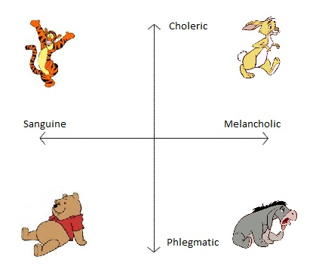
WHY YOU ACT THE WAY YOU DO?
WHAT IS TEMPERAMENTS
They are our patterns of behaviour… the ways we usually respond to situations. According to Psychologists, the innate aspects of an individual’s personality such as introversion or extroversion is termed Temperament. It is also defined as a persons nature, ones usual way of thinking or acting. They are instinctive or natural behaviours, rather than learned behaviours.
THE TEMPERAMENT TYPES
Four types of temperament
have been identified
SANGUINE
CHOLERIC
MELANCHOLIC
PHLEGMATIC
– recently discovered

Slide 6
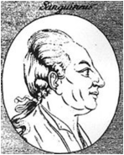
SANGUINE
- STRENGTHS – WEAKNESSES
Enjoy life and always happy
Optimistic/confident
Excel in communication oriented things
Talkative
Warm (have sympathy for people)
They are approachable
Sincere and helpful
Independent
Forgetful
Unreliable
Naïve (behave like children or people without experience
They do not want to be alone
Superficial (Surface thinking)
Very demanding
Unstable
Exaggeration
Stubborn
Does many things at once and does not always complete
SANGUINE (AIR)
EXTROVERT LEADER
(QUICK TEMPERED)
A sanguine is an extrovert who has a high need to include and be close to others.
A sanguine is always cheerful, hopeful, confident and expect the best in everything he/she does in life. They always enjoy life
A sanguine never thinks of failure or loss in everything
They are authoritative or autocratic
THE SPECIAL ROLE
OF THE SANGUINE
ACTING - THEY CAN ACT
VERY WELL IN PUBLIC
Sales - they are very good business men and women
They make excellent masters of ceremonies (MC)
Very good auctioneers
Speeches
Evangelism
Prophesying
Fighting or boxing
1. SANGUINE: Sanguine is a sociable person. They laugh for the hard days, wise words when squeezed by the burden, creative, enthusiasm, and always have the energy to start. Sanguine love to be popular. They have a lot of friends. They love to talk, to perform, help each other and they always curious. Sanguine love to be children forever

Slide 7
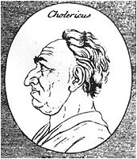
CHOLERIC
STRENGTHS – WEAKNESSES
Activists (take part in public events)
Opportunist
Hard driving
Optimistic/confident
Perfectionist
Friendly
Tough minded Fearless
Action oriented
Quick tempered
Offensive
Proud
Cruel
Rash decision making
Rude
Self-catered
CHOLERIC (FIRE) 1
(Destructive Temperament)
Extrovert leader According to scholars, Choleric is the most powerful and destructive temperament.
They tend to be users.
They do not forget easily.
They are very quick tempered
They seldom change their mind even if they are wrong.
They want total control over themselves and everyone around them.
THE SPECIAL ROLE
OF THE CHOLERIC
In organisations, they become very good executive officers
They are very good producers
They can be very good building engineers
Very good materials for politics
In the religious organisations, they become very good evangelists and prophets
They become very good opinion leaders in society
In marriage they play very high romantic roles
2. CHOLERIC : Choleric is a strong person. They have a strong leadership. They are faithful, brave, and have the freedom to be on one's own. They all forced and always want to make a change. Strong-willed and assertive, goal oriented, well organized, and they don't really need friends. They always be the superior one in the emergency time.

Slide 8
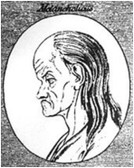
MELANCHOLIC (EARTH)
INTROVERT
(PERFECTIONIST)
Melancholic's approach very few people for association and they do not like to be approached for association. They are very selective with whom they socialise.
According to scholars, melancholic are very family oriented, closely bonded to individuals within the family unit.
They see life as a goal to achieve . Due to their intelligence they predict pitfalls in a project before they undertake it.
MELANCHOLIC
- STRENGTHS & WEAKNESSES
Perfectionists
Analytical
Great understanding
Self-sacrificial
Aesthetics (show beauty in their ding)
Gifted (have extraordinary talents)
Good decision making people
Good leaders
They are responsible
Faithfulness and loyalty
Dependable
Deep commitment
Lonely/private
Suicidal tendencies
Easily depressed
Sometimes procrastinate
Revengeful
Emotional
Non – romantic
Secretive
SPECIAL ROLE
OF THE MELANCHOLIC
Most of the worlds greatest composers, inventors, philosophers, theologians, musicians, artists, educators, medical doctors were predominantly melancholic.
Excellent humanitarians
Authors
Great Investors
MELANCHOLIC ARE
They are perfectionists and set very high standards for themselves and for other people around them.
They are self motivated and do not respond to the promise of reward or the threat of punishment.
They become very sad when things go wrong
Therefore they analyse and plan before done and want it to be very perfect.
They can be extremely quiet people who never talk to son, daughter, or even spouse.
3. MELANCHOLIC: Melancholies is a sensitive person. Depth to see the heart and soul of life. Artistic to appreciate the art. They are thoughtfully analytical, serious, and have a talent, they are perfectionist, so they love details. Melancholies looking for some ideal mate.

Slide 9
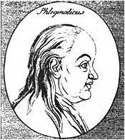
PHLEGMATIC
STRENGTHS - WEAKNESSES
Peace loving and peace maker
Even tempered
Balanced (adjust to every situation)
Kind hearted
Even loving
Do not discriminate
Easy going
Not demanding
Witty consistent
Uninvolving
Not opportunists
Indecisive
Unemotional and inexpressive
Rarely self-sacrificing (do not want to sacrifice themselves for affection)
Unwillingness to become involved in deep relationships with people of the opposite sex
Procrastination
Verbal defences
PHLEGMATIC
(WATER)
(PEACE MAKER)
This is the only temperament that is basically moderate
They are very peaceful at heart making them great assets social, political, friendship, business etc.
They seldom use ideas and talents they have because it requires to much energy and active participation.
They sit back and watch other temperaments busy doing things wrongly and looking at all the wrong things in the world that need to be changed
They easily identify the injustice but hardly take any action
THE SPECIAL ROLE
OF THE PHLEGMATIC
They can be good teachers or educators
They play effective roles in leadership
They are mostly scientists
They enjoy meticulous work;
any work that need carefulness and planning
They become very good diplomats and good administrators
Become very good accountants
They are very good pastors
PHLEGMATIC: Phlegmatic is a peaceful person. They always stable, patient, and have a compassion for the other. They always keep calm, when the other was in confusion. They are humble, silent, controlled, good listener, and always happy with their life. They always be the mediator, and easy to get along with.

Slide 10
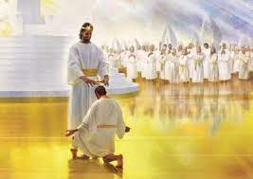
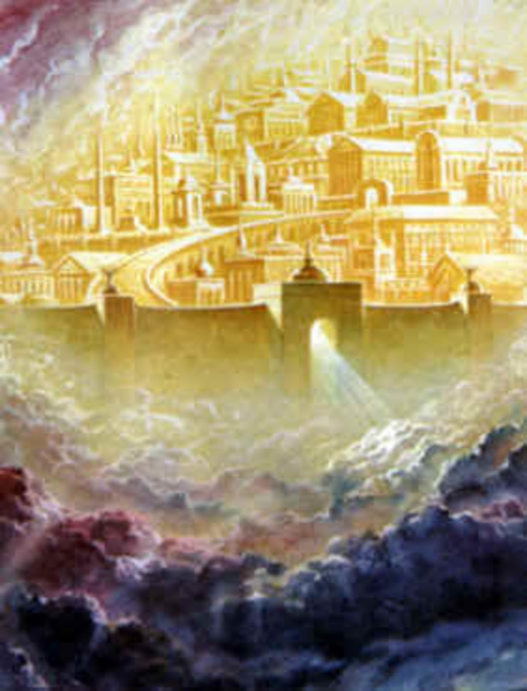
12 GATES AND 12 STONES AND 12 TIPE OF CHARACTERS
REVELATION 21: 12- 21
THE CHARACTERS OF THE 12 TRIBES OF ISRAEL AND THE SAME CHARACTERS OF THE 144000 ARE APROVED AND WILL REMAIN FOREVER IN HEAVEN. IT IS CONFIRMED BY THE FACT OF THE EXISTANTS OF THE 12 GATES ACORDING TO THE NAMES OF EACH TRIBE OF ISRAEL WHICH REPRESENT EACH APPROVED 12 TIPE OF CHARACTERS.

Slide 11
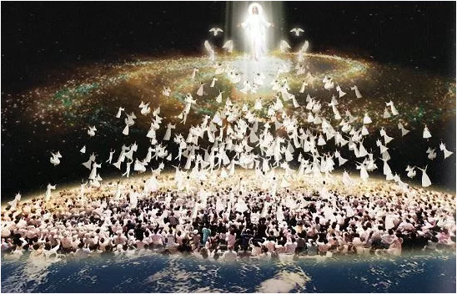
WHEN CHRIST SHALL COME
“There is really no place in heaven for these dispositions. A man with such a character will only make heaven miserable, because he himself is miserable. “Except ye be born again,” said Christ, “ye cannot enter the kingdom of heaven.” To enter heaven, a man must have Christ formed within, the hope of glory, and take heaven with him. The Lord Jesus alone can fashion and change the character. For want of patience, kindness, forbearance, unselfishness, and love, the revealing's of the traits flash forth involuntarily when off guard, and unchristian words, unchristlikeness of character burst forth sometimes to the ruin of the soul.” {FE 279.1}

Slide 12
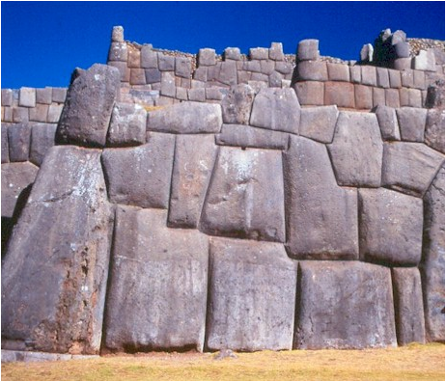
POLISHING OF CHARACTER
MUST BE DONE DURING MAN’S PROBATION
“”The stones were not prepared for their respective places just as they were about to be laid in the wall of the temple; all the fitting and planning was done previous to their being brought to the place of building. So it is that all the hewing, fitting and polishing of character must be done during man’s probation. When Christ shall come again to earth it will not be to purify and refine the characters of men, and to fit them for Heaven. His work then will only be to change their corruptible bodies and fashion them like unto Christ’s most glorious body. Only a symmetrical and perfect character will in that day entitle men to the finishing touch of immortality.” {3SP 40.2}
“Earth is the quarry and the work-shop where men are to be fitted and refined for the courts of Heaven. As the stones composing Solomon’s temple came together in the wall a perfect fit, without the touch of ax or hammer or any other instrument, so will the resurrected saints, and those who are alive at the time of his coming be caught up together to meet the Lord in the air, each one fitted for the great change and taking his proper place in the temple of God’s love.” {3SP 41.1}

Slide 13
QUESTIONS
IF GOD CREATED 12 TYPES OF DIFFERENT KIND OF HUMAN CHARACTERS THEN WHAT WENT WRONG TO BECOME SO CORRUPTED THE HUMAN NATURE?
WHO KEEP THE ORIGINAL CHARACTER OF THE HUMANKIND? - ADAM, EVA, CHRIST, GOD, GOD’S CHILDREN, GOD’S LAW
HOW AND BY WHOM IS EXPRESSED
THE ORIGINAL CHARACTER?
‘’Christ Overcame Sin as a Man— The fall of our first parents broke the golden chain of implicit obedience of the human will to the divine. Obedience has no longer been deemed an absolute necessity. The human agents follow their own imaginations, which the Lord said of the inhabitants of the old world were evil and that continually. The Lord Jesus declares, I have kept My Father’s commandments. How? As a man. Lo, I come to do Thy will, O God. To the accusations of the Jews He stood forth in His pure, virtuous, holy character and challenged them, “Who of you convinced me of sin?” {3SM 138.2}

Slide 14
MAKE PLAIN
THE PLAN OF SALVATION
WHY CHRIST UTTERED THINGS KEPT SECRET?
“THE TRUTH AS IT IS” - STUDY PROGRAM
CHRIST IS COMING SOON – ARE WE READY?

Slide 15
I WILL UTTER THINGS KEPT SECRET
FROM THE FOUNDATION OF THE WORLD
“But blessed are your eyes for they see, and your ears for they hear; for assuredly, I say to you that many prophets and righteous men desired to see what you see, and did not see it, and to hear what you hear, and did not hear it.” MATTHEW 13: 16,17
“I will open My mouth in parables; I will utter things kept secret
from the foundation of the world.”
Matthew 13:35

Slide 16
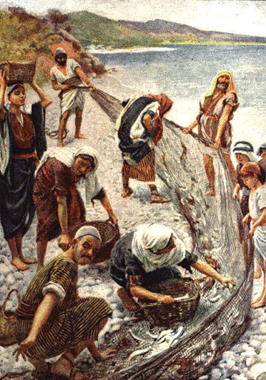
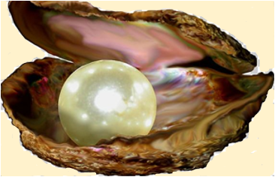
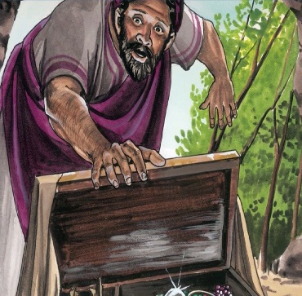
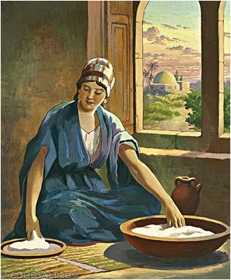
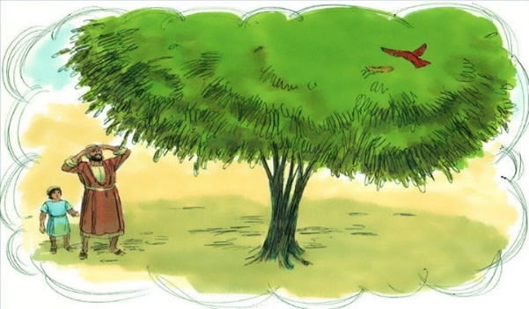
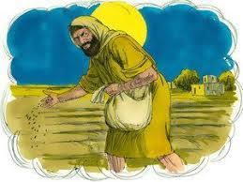
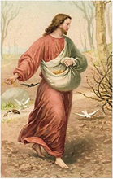
I WILL UTTER THINGS KEPT SECRET
THE PARABLE OF THE DRAGNET
1.
THE PARABLE OF THE SOWER EXPLAINED
1. BY THE WAYSIDE
2. ON STONY PLACES
3. seed among
the thorns
4. SEED ON THE
GOOD GROUND
THE PEARL OF GREAT PRICE
THE HIDDEN TREASURE
THE PARABLE OF THE LEAVEN
THE MUSTARD SEED
THE WHEAT AND THE TARESD
“I will open My mouth in parables; I will utter things kept secret
from the foundation of the world.”
Matthew 13:35

Slide 17
“HAVE YOU UNDERSTOOD ALL THESE THINGS?”
⁵¹ Jesus said to them, “Have you understood all these things?”
They said to Him, “Yes, Lord.” ⁵² Then He said to them, “Therefore every scribe
instructed concerning the kingdom of heaven is like a householder who brings
out of his treasure things new and old.” MATTHEW 13: 51,52
JESUS REJECTED AT NAZARETH
⁵³ Now it came to pass, when Jesus had finished these parables, that He departed from there. ⁵⁴ When He had come to His own country, He taught them in their synagogue, so that they were astonished and said, “Where did this Man get this wisdom and these mighty works? ⁵⁵ Is this not the carpenter’s son?
Is not His mother called Mary? And His brothers James, Joses, Simon, and Judas?
⁵⁶ And His sisters, are they not all with us? Where then did this Man get all these things?”
⁵⁷ So they were offended at Him.
But Jesus said to them, “A prophet is not without honour except in his own country and in his own house.” ⁵⁸ Now He did not do many mighty works there because of their unbelief. MATTHEW 13: 53 - 58

Slide 18
EVERY STAGE OF ITS GROWTH THE EXPERIENCE
REPRESENTED IN THE PARABLE IS REPEATED
“Not only is the growth of Christ’s kingdom illustrated by the parable of the mustard seed, but in every stage of its growth the experience represented in the parable is repeated. For His church in every generation God has a special truth and a special work. The truth that is hid from the worldly wise and prudent is revealed to the child-like and humble. It calls for self-sacrifice. It has battles to fight and victories to win. At the outset its advocates are few. By the great men of the world and by a world-conforming church, they are opposed and despised. See John the Baptist, the forerunner of Christ, standing alone to rebuke the pride and formalism of the Jewish nation. See the first bearers of the gospel into Europe…” {COL 78.2}

Slide 19
NAUGHTY THAT DEFILED CAN NEVER ENTER THERE. IN ALL THE REDEEMED HOST NOT ONE DEFECT WILL BE SEEN
The longest journey is performed by taking one step at a time. A succession of steps brings us to the end of the road. The longest chain is composed of separate links. If one of these links is faulty, the chain is worthless. Thus it is with character. A well-balanced character is formed by single acts well performed. One defect, cultivated instead of being overcome, makes the man imperfect, and closes against him the gate of the Holy City. He who enters heaven must have a character that is without spot or wrinkle or any such thing. Naught that defiled can ever enter there. In all the redeemed host not one defect will be seen. –Messages to Young People, p. 144.

Slide 20
THE KINGDOM OF HEAVEN IS LIKE..
7. A NET, THAT WAS CAST INTO THE SEA
7. OVERCAME
CHRIST REPRESENTED BY THE SEVEN PARABLES THE HIDING, SYMBOLIC AND THE SECRET WAY OF THE SEVEN STEPS OF OUR SPIRITUAL CHARACTER BY TRANSFORMATION
TO THE ORIGINAL CHRISTLIKE CHARACTER.
6. SANCTIFIED
5. FOUND TREASURE HID IN A FIELD
5. REDEEMED
4. RECONCILED
3. GRAIN OF MUSTARD SEED
3. REMISSION OF SINS
2. LET BOTH GROW TOGETHER
2. CLEANSE
1. A SOWER WENT FORTH TO SOW
1. JUSTIFIED

Slide 21
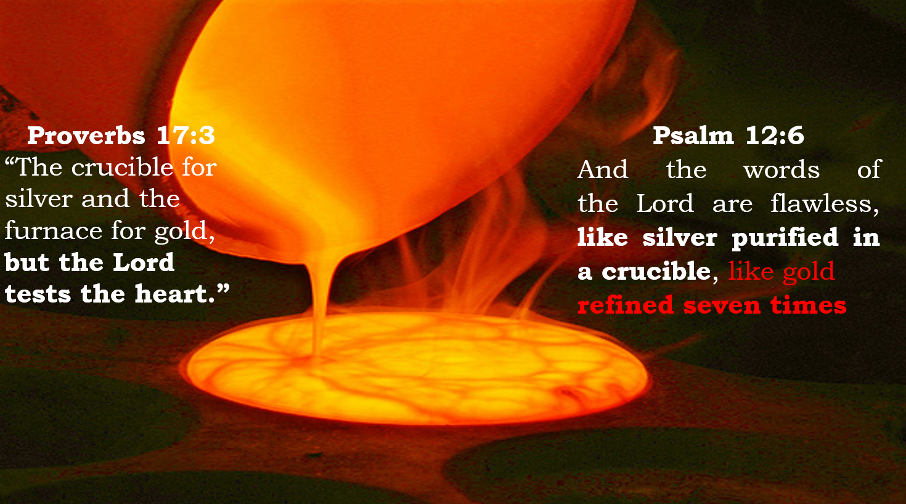
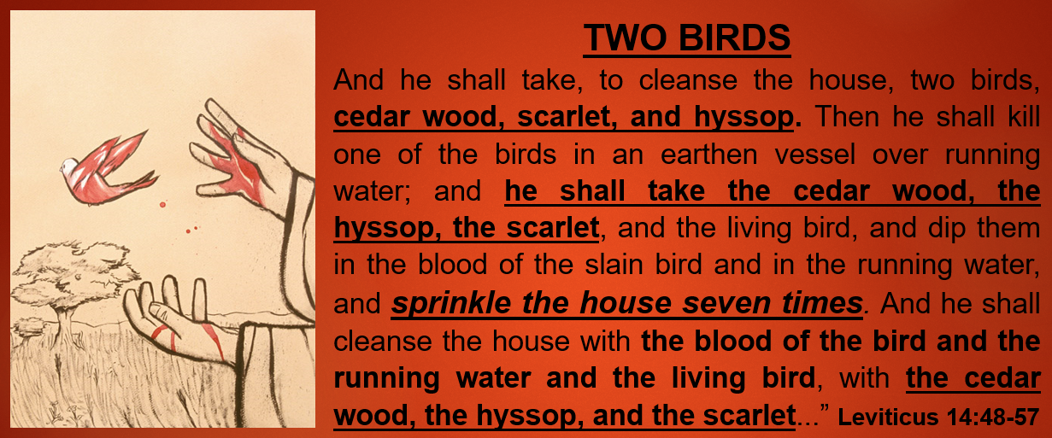
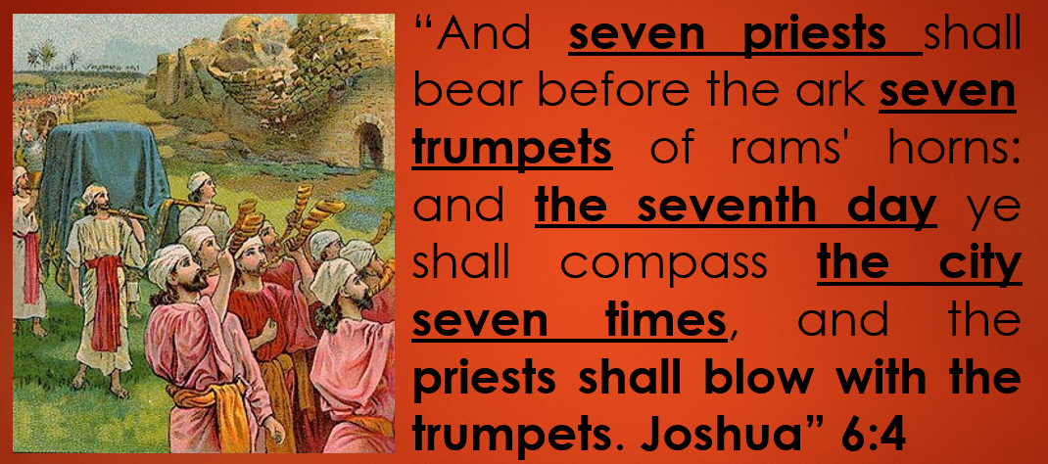
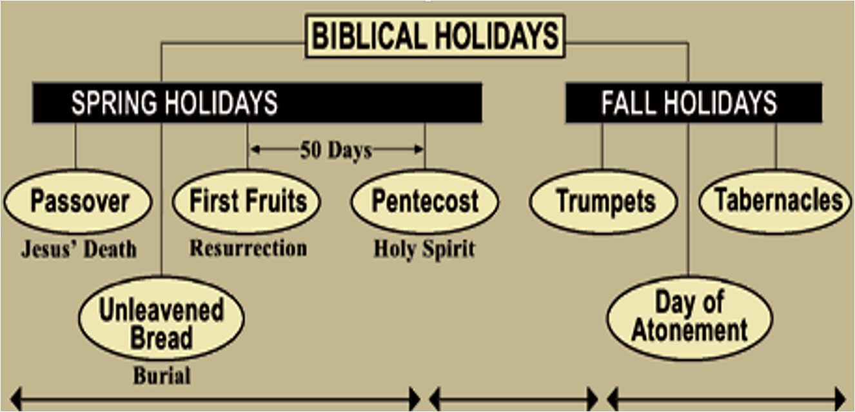
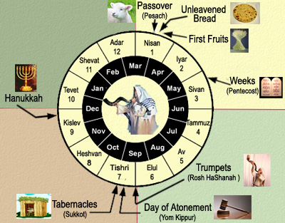
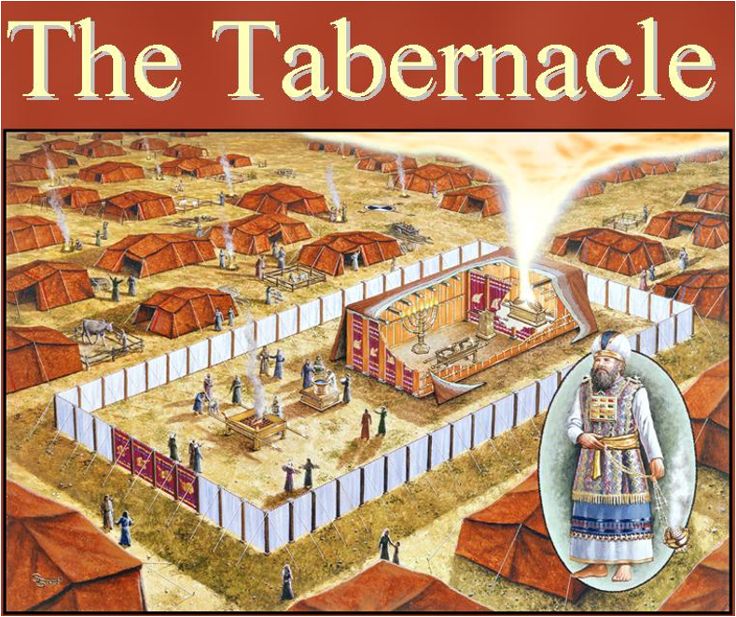
GOD USE NUMBER SEVEN TO EXPRESS PERFECTION OR COMPLETENESS OF SOMETHING WHICH WAS OR WILL BE DONE FROM HIM, HOLY SPIRIT AND FROM US

Slide 22
THE RELIGION OF CHRIST MEANS
“THE RELIGION OF CHRIST A/ means more than the forgiveness of sin; B/ it means taking away our sins, and filling the vacuum with the graces of the Holy Spirit. C/ It means divine illumination, rejoicing in God. D/ It means a heart emptied of self, and blessed with the abiding presence of Christ.
WHEN CHRIST REIGNS IN THE SOUL, 1/ there is purity, 2/freedom from sin. 3/The glory,4/the fullness,5/the completeness of the gospel plan is fulfilled in the life. 6/The acceptance of the Saviour brings a glow of perfect peace, perfect love, and perfect assurance. 7/The beauty and fragrance of the character of Christ revealed in the life testifies that God has indeed sent His Son into the world to be its Saviour.” {COL 419.6}

Slide 23
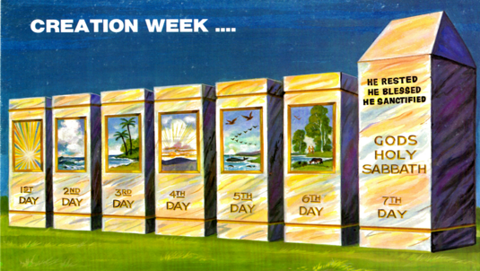
WHY GOD WANTS TO BE RESPECT THE LITERAL WEEKLY SABBATH
ACCORDING TO THE COMMANDMENT?
“And they rested on the Sabbath according to the commandment.” Luke 23:56
⁸ “Remember the Sabbath day, to keep it holy. ⁹ Six days you shall labour and do all your work, ¹⁰ but the seventh day is the Sabbath of the Lord your God. In it you shall do no work: you, nor your son, nor your daughter, nor your male servant, nor your female servant, nor your cattle, nor your stranger who is within your gates. ¹¹ For in six days the Lord made the heavens and the earth, the sea, and all that is in them, and rested the seventh day. Therefore the Lord blessed the Sabbath day and hallowed it. Exodus 20:8-11

Slide 24
REMAINS THEREFORE A SABBATH REST
FOR THE PEOPLE OF GOD
“Let us therefore fear, lest, a promise being left us of entering into his rest, any of you should seem to come short of it.
² For unto us was the gospel preached, as well as unto them: but the word preached did not profit them, not being mixed with faith in them that heard it.
³ For we which have believed do enter into rest, as he said, As I have sworn in my wrath, if they shall enter into my rest: although the works were finished from the foundation of the world.
⁴ For he spake in a certain place of the seventh day on this wise, And God did rest the seventh day from all his works.
9 There remains therefore a rest for the people of God. 10 For he who has entered his rest has himself also ceased from his works as God did from his.” Hebrews 4:1-4, 9-10
BY OUR SPIRITUAL ENTERING BY FAITH INTO GOD’S REST CHRIST WILL HEAL AND SANCTIFY OUR CORAPTED NATURE FOR SIX SIMBOLIC SPIRITUAL DAYS (STAGES) AND THAN AT THE SEVEN DAY GOD WILL REST AT THE SEVENTH DAY (STAGES) WITH HIS HEALED SPIRITUALY FROM HIM FAITHFUL CHILDREN

Slide 25
OLD TESTAMENT
CEREMONIAL STAGES
OF SPIRITUAL GROWING
7- VICTORY
ATTAIN UNTO THE
RESURRECTION OF THE DEAD
3
6- REDEMTION
VICTORY
CONFORMABLE UNTO HIS DEATH
5 - SANCTIFICATION
THE FELLOWSHIP OF HIS SUFFERINGS
2
4 - RECONCILIATION
- RESURRECTION
SANCTIFICATION
3 - JASTIFICATION -
I MAY KNOW HIM
1
JASTIFICATION
2 – CLEANING -
RIGHTEOUSNESS
1 – FORGIVNESS - (REMISSION)
THE FAITH OF CHRIST

Slide 26
MAKE PLAIN
THE PLAN OF SALVATION
PART 3
CHRIST AND OURS SPECIAL MESSION FOR THOSE WHO ARE WILLING TO COOPERATE
POINT - 1
GOD”S SISTEM OF WORK
“THE TRUTH AS IT IS” - STUDY PROGRAM
CHRIST IS COMING SOON – ARE WE READY?

Slide 27
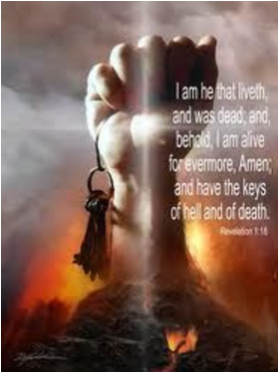
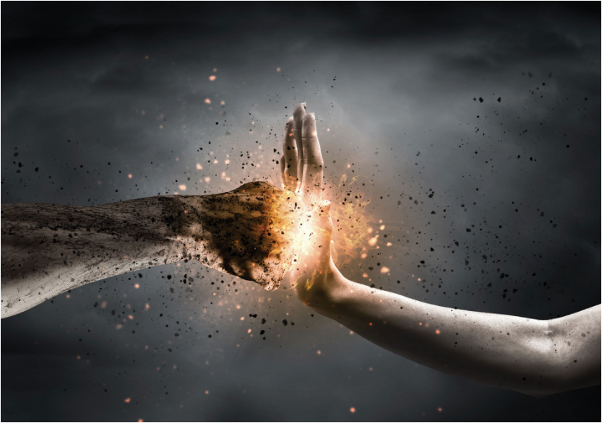
GOD PUT ALL HEAVEN
INTO CHRIST’S HANDS
As we walk the streets, or wherever we are, Satan is on our track.! When Christ engaged to fight the battles for man on this little speck of a world, He engaged to stand as our substitute and surety, and God put all heaven into His hands, with all the facilities and all the powers that heaven could afford. Now heaven is open to man, and the light and the glory of heaven is imparted to him through the merits of Jesus Christ our Lord. {2SAT 59.1}

Slide 28
^{WHAT IS THE NAME OF THE LORD?}
HOW GOD REPRESENT HIMSELF TO MOSSES?
WHY CHRIST HAS USE SEVEN NAMES?
⁵ Now the Lord descended in the cloud and stood with him there, and proclaimed the name of the Lord. ⁶ And the Lord passed before him and proclaimed,
“ 1/ The Lord,
2/ the Lord God,
3/ merciful
4/ and gracious,
5/ longsuffering,
6/ and abounding in goodness
7/ and truth.” Exodus 34:6
THE NAME
OF THE LORD
1/ THE LORD,
2/ THE LORD GOD
3/ MERCIFUL
4/ GRACIOUS
5/ LONGSUFFERING
6/ GOODNESS
7/ TRUTH

Slide 29
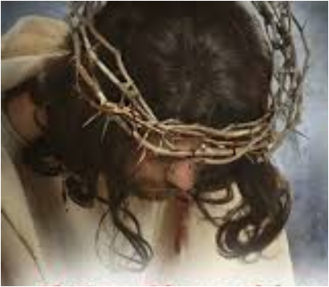
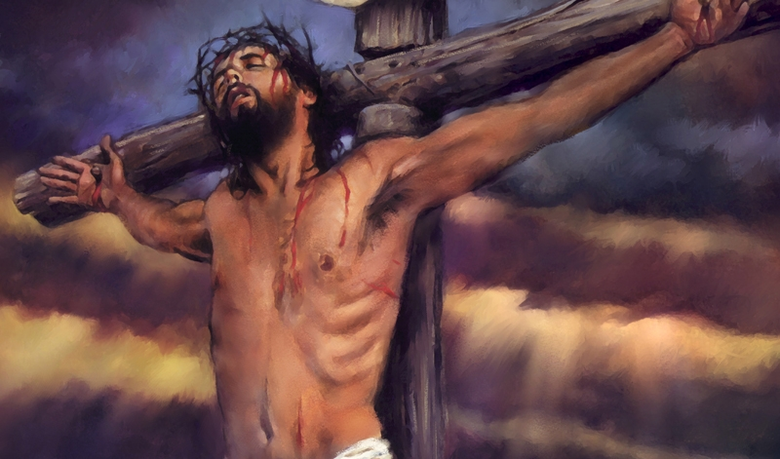
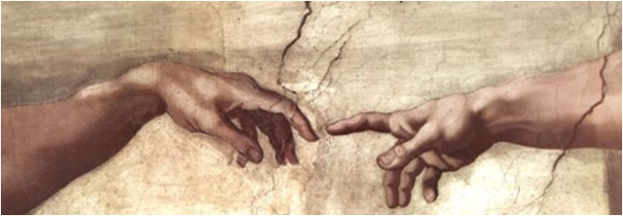
THE CEREMONY
OF CHRIST CORONATION
THE DISCIPLES DID NOT DISCERN THAT:
1. In the place of HIS EXALTATION TO THE THRONE OF DAVID they were to witness HIS CRUCIFIXION. - This was to be indeed CHRIST TRUE CORONATION.
2. Mark 15:17 “THEY CLOTHED HIM WITH PURPLE; “THEN AFTER THEY TOOK HIS ROBE.”
3...and THEY TWISTED A CROWN OF THORNS, PUT IT ON HIS HEAD”
4. Matthew 27:29 “When they had twisted a crown of thorns, they put it on his head, and a REED IN HIS RIGHT HAND.”
5. And THEY BOWED THE KNEE BEFORE HIM AND MOCKED HIM,
6… saying, “HAIL, KING OF THE JEWS!”
7. John 19:5 - Pilate said to them, “BEHOLD THE MAN! - Mark 15:9 Pilate answered them, saying, “Do you want me to release to you the King of the Jews?” Now Pilate wrote a title and put it on the cross. And the writing was: JESUS OF NAZARETH, THE KING OF THE JEWS.
Yes, this was the ceremony of Christ coronation of Christ when by His dead additionally He become a king not only of Israel but of the Earth and the Humankind

Slide 30
7/ THEY OVERCAME BY THE BLOOD OF THE LAMB
“And they overcame him by the blood of the Lamb and by the word of their testimony, and they did not love their lives to the death.” Revelation 12:11
SEVEN FUNDAMENTAL
SALVATION STEPS
6/ REDEEMED BY THE PRECIOUS BLOOD OF CHRIST
“Knowing that you were not redeemed with corruptible things, like silver or gold, from your aimless conduct received by tradition from your fathers, 19 but with the precious blood of Christ, as of a lamb without blemish and without spot. 1 Peter 1:18-19
7. OVERCAME
Revelation 12:11
5/ THE BLOOD OF THE COVENANT BY WHICH HE WAS SANCTIFIED
Of how much worse punishment, do you suppose, will he be thought worthy who has trampled the Son of God underfoot, counted the blood of the covenant by which he was sanctified a common thing, and insulted the Spirit of grace? Hebrews 10:29
6. REDEEMED
1 Peter 1:18-19
5. SANCTIFIED
SEVEN FUNDAMENTAL SALVATION STEPS
4/ WE WERE RECONCILED
“For if when we were enemies we were reconciled to God through the death of His Son, much more, having been reconciled, we shall be saved by His life.” Romans 5:10
Hebrews 10:29
4. RECONCILED
Romans 5:10
3/ THE BLOOD SHED FOR REMISSION OF SINS
“For this is My blood of the new covenant, which is shed for many for the remission of sins.” Matthew 26:28
3. REMISSION
OF SINS
Matthew 26:28
2/ THE BLOOD OF CHRIST CLEANSES US FROM ALL SIN
“But if we walk in the light as He is in the light, we have fellowship with one another, and the blood of Jesus Christ His Son cleanses us from all sin.” 1 John 1:7
2. CLEANSE
1 John 1:7
1. JUSTIFIED
1/ WE ARE JUSTIFIED BY CHRIST’S BLOOD
1/ God commended his love toward us, in that, while we were yet sinners, Christ died for us. Much more then, being now justified by his blood, we shall be saved from wrath through him. Romans 5:8, 9
Romans 5:8, 9

Slide 31
CHRIST SEVEN STEPS
OF HIS VICTORY
7/ EVERY TONGUE SHOULD CONFESS THAT JESUS CHRIST IS LORD, TO THE GLORY OF GOD THE FATHER.
1/ BEING IN THE FORM OF GOD, THOUGHT IT NOT ROBBERY TO BE EQUAL WITH GOD
PHILIPPIANS 2:5-11
THE HUMBLED AND EXALTED CHRIST
“Let this mind be in you which was also in Christ Jesus, ⁶ who, being in the form of God, did not consider it robbery to be equal with God, ⁷ but made Himself of no reputation, taking the form of a bondservant, and coming in the likeness of men. ⁸ And being found in appearance as a man, He humbled Himself and became obedient to the point of death, even the death of the cross. ⁹ Therefore God also has highly exalted Him and given Him the name which is above every name, ¹⁰ that at the name of Jesus every knee should bow, of those in heaven, and of those on earth, and of those under the earth, ¹¹ and that every tongue should confess that Jesus Christ is Lord, to
the glory of God the Father.”
6/ THAT AT THE NAME OF JESUS EVERY KNEE SHOULD BOW, OF THINGS IN HEAVEN, AND THINGS
IN EARTH
2/ TOOK UPON HIM THE
FORM OF A SERVANT,
AND WAS MADE
IN THE LIKENESS OF MEN:
5/ GOD ALSO HATH HIGHLY
EXALTED HIM, AND
GIVEN HIM A NAME
WHICH IS ABOVE EVERY NAME
3/ HE HUMBLED HIMSELF
4/BECAME OBEDIENT UNTO DEATH,
EVEN THE DEATH OF THE CROSS.

Slide 32
GREAT IS THE MYSTERY OF GODLINESS OF CHRIST
1/ HE (GOD)
1 TIMOTHY 3:16
7/ WAS TAKEN
UP IN GLORY
“And without controversy great is the mystery of godliness: God was manifest in the flesh, justified in the Spirit, seen of angels, preached unto the Gentiles, believed on in the world, received up into glory.”
2/ APPEARED
IN THE FLESH,
6/ WAS BELIEVED
ON IN THE WORLD,
WAS TAKEN UP IN GLORY
“MANY WHO ARE FIRST WILL BE LAST AND THE LAST FIRST.”
TAKE UP HIS CROSS DAILY AND FOLLOW ME.
I AM - THE FIRST AND LAST - HAMBLE HIMSELF
3/ WAS VINDICATED BY THE SPIRIT
5/ WAS PREACHED
AMONG THE NATIONS,
4/ WAS SEEN
BY ANGELS,

Slide 33
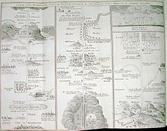
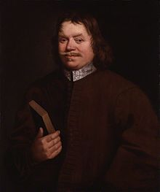
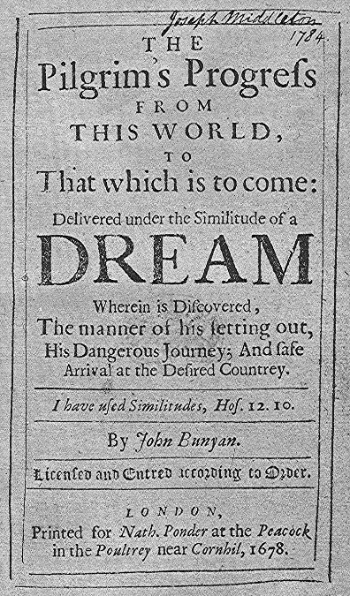
THE PILGRIM'S PROGRESS
FROM THIS WORLD TO THAT WHICH IS TO COME
BY JOHN BUNYAN
A map of the places Pilgrim travels through on his progress; a fold-out map from an edition printed in England in 1778
City of Destruction, Christian's home, representative of the world (cf. Isaiah 19:18)
Slough of Despond, the miry swamp on the way to the Wicket Gate; one of the hazards of the journey to the Celestial City. In the First Part, Christian falling into it, sank further under the weight of his sins (his burden) and his sense of their guilt.
Mount Sinai, a frightening mountain near the Village of Morality that threatens all who would go there.
Wicket Gate, the entry point of the straight and narrow way to the Celestial City. Pilgrims are required to enter by way of the Wicket Gate. Beelzebub's castle was built not very far from the Gate.
House of the Interpreter, a type of spiritual museum to guide the pilgrims to the Celestial City, emblematic of Calvary and the tomb of Christ.
Hill Difficulty, both the hill and the road up is called "Difficulty"; it is flanked by two treacherous byways "Danger" and "Destruction." There are three choices: Christian takes "Difficulty" (the right way), and Formalist and Hypocrisy take the two other ways, which prove to be fatal dead ends.
House Beautiful, a palace that serves as a rest stop for pilgrims to the Celestial City. It apparently sits atop the Hill Difficulty. From the House Beautiful one can see forward to the Delectable Mountains. It represents the Christian congregation, and Bunyan takes its name from a gate of the Jerusalem temple (Acts 3:2, 10).
Valley of Humiliation, the Valley on the other side of the Hill Difficulty, going down into which is said to be extremely slippery by the House Beautiful's damsel Prudence. It is where Christian, protected by God's Armor, meets Apollyon and they had that dreadful, long fight where Christian was victorious over his enemy by impaling Apollyon on his Sword of the Spirit (Word of God) which caused the Foul Fiend to fly away. Apollyon met Christian in the place known as "Forgetful Green." This Valley had been a delight to the "Lord of the Hill", Jesus Christ, in his "state of humiliation."
Valley of the Shadow of Death, a treacherous, devilish Valley filled with demons, dragons, fiends, satyrs, goblins, hobgoblins, monsters, creatures from the bottomless pit, beasts from the mouth of Hell, darkness, terror, and horror with a Slough of Despond, bog on one side and a deep chasm/ditch on the other side of the King's Highway going through it (cf. Psalm 23:4).
Gaius' Inn, a rest stop in the Second Part of the Pilgrim's Progress.
Vanity Fair, a city through which the King's Highway passes and the yearlong Fair that is held there.
Plain Ease, a pleasant area traversed by the pilgrims.
Hill Lucre, location of a reputed silver mine that proves to be the place where By-Ends and his companions are lost.
The Pillar of Salt, which was Lot's wife, who was turned into a pillar of salt when Sodom and Gomorrah were destroyed. The pilgrim's note that its location near the Hill Lucre is a fitting warning to those who are tempted by Demas to go into the Lucre silver mine.
River of God or River of the Water of Life, a place of solace for the pilgrims. It flows through a meadow, green all year long and filled with lush fruit trees. In the Second Part the Good Shepherd is found there to whom Christiana's grandchildren are entrusted.
By-Path Meadow, the place leading to the grounds of Doubting Castle.
Doubting Castle, the home of Giant Despair and his Giantess wife, Diffidence; only one key could open its doors and gates, the key Promise.
The Delectable Mountains, known as "Immanuel's Land." Lush country from whose heights one can see many delights and curiosities. It is inhabited by sheep and their shepherds, and from Mount Clear one can see the Celestial City.
The Enchanted Ground, an area through which the King's Highway passes that has air that makes pilgrims want to stop to sleep. If one goes to sleep in this place, one never wakes up. The shepherds of the Delectable Mountains warn pilgrims about this.
The Land of Beulah, a lush garden area just this side of the River of Death.
The River of Death, the dreadful river that surrounds Mount Zion, deeper or shallower depending on the faith of the one traversing it.
The Celestial City, the "Desired Country" of pilgrims, heaven, the dwelling place of the "Lord of the Hill", God. It is situated on Mount Zion.
OF THE FAITHFUL ONE, WHO FOLLOW THE EXAMPLE OF CHRIST

Slide 34
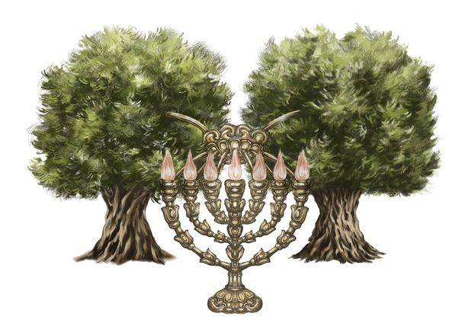
GOD”S SISTEM OF WORK FOR SALVATION FOR THESE WHO ARE
WILLING TO COOPERATE WITH OUR SAVIOUR AND THE HOLY SPIRIT
² And he said to me, “What do you see?” So I said, “I am looking, and there is a lampstand of solid gold with a bowl on top of it, and on 1/the stand seven lamps with 2/ seven pipes 3/to the seven lamps.
³ Two olive trees are by it, one at the right of the bowl and the other at its left.” ⁴ So I answered and spoke to the angel who talked with me, saying, “What are these, my Lord?” ⁵ Then the angel who talked with me answered and said to me, “Do you not know what these are?” … “What are these two olive branches that drip into the receptacles of the two gold pipes from which the golden oil drains?” ¹³ Then he answered me and said, “Do you not know what these are?” And I said, “No, my lord.” ¹⁴ So he said, “These are the two anointed ones, who stand beside the Lord of the whole earth.” Zechariah 4:2-4,13
TWO OLIVE TREES
1/ LAMPSTAND OF SOLID GOLD WITH A BOWL ON TOP OF IT
2 / WITH SEVEN PIPES
3/ TO THE SEVEN LAMPS
And I will give power to my two witnesses, and they will prophesy one thousand two hundred and sixty days, clothed in sackcloth.” These are the two olive trees and the two lampstands standing before the God of the earth. Revelation 11:3, 4

Slide 35
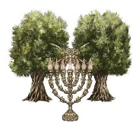
WHO ARE THE TREES OF LIFE IN THE PARADISE OF GOD?
1. WHO IS HE WHO REPRESENT ONE OF THE TREE?“ To all who believe, HE IS AS THE TREE OF LIFE IN THE PARADISE OF GOD. His branches reach to this world, that THE BLESSINGS WHICH HE HAS PURCHASED FOR US may be brought within our reach....”
ANSWER: ONLY CHRIST CAN BE
2. WHO IS ANOTHER PERSONALITIY WHO REPRESENT THE ANOTHER TREE? “…HE HAS GIVEN US A COMFORTER, THE HOLY SPIRIT, which WILL **PRESENT TO US THE PRECIOUS FRUIT FROM THE TREE OF LIFE. From this tree we may pluck and eat, and we may then guide others to it, that they also may eat. {ML 50.2}
3. “THE “TWO WITNESSES” represent THE SCRIPTURES OF THE OLD AND THE NEW TESTAMENT, important testimonies to THE ORIGIN AND PERPETUITY OF THE LAW OF GOD, and ALSO TO THE PLAN OF SALVATION.” {HF 167.3}
4.“THE MAN WHO LOVES GOD meditates on the law of God day and night. He is instant in season and out of season. HE BEARS THE FRUIT OF A BRANCH VITALLY CONNECTED WITH THE VINE. AS HE HAS OPPORTUNITY, HE DOES GOOD; AND EVERYWHERE, AT ALL TIMES AND IN ALL PLACES, HE FINDS OPPORTUNITY TO WORK FOR GOD. HE IS ONE OF THE LORD’S EVERGREEN TREES; and HE CARRIES FRAGRANCE WITH HIM WHEREVER HE GOES. A WHOLESOME ATMOSPHERE SURROUNDS HIS SOUL. The beauty of his well-ordered life and godly conversation inspires faith and hope and courage in others. THIS IS CHRISTIANITY IN PRACTICE. SEEK TO BE AN EVERGREEN TREE. Wear the ornament of a meek and quiet spirit, which is in the sight of God of great price. Cherish the grace of love, joy, peace, longsuffering, gentleness. THIS IS THE FRUIT OF THE CHRISTIAN TREE. Planted by the rivers of water, it always brings forth its fruit in due season.” {ML 50.3}

Slide 36
THE SAME IMAGE FROM GLORY TO GLORY
“We all, with open face beholding as in a glass the glory of the Lord, are changed into the same image from glory to glory even as by the Spirit of the Lord”
(2 Corinthians 3:18)
“To those the angel who unites in the proclamation of the third message is to lighten the whole earth with his glory… {GC 611.1}
“It is impossible for any of us by our own power or our own efforts to work this change in ourselves. It is the Holy Spirit, the Comforter, which Jesus said He would send into the world, that changes our character into the image of Christ; and when this is accomplished, we reflect as in a mirror the glory of the Lord. That is, the character of the one who thus beholds Christ is so like His that one looking at him sees Christ's own character shining out as from a mirror. Imperceptibly to ourselves, we are changed day by day from our ways and will into the ways and will of Christ, into the loveliness of His character. Thus we grow up into Christ, and unconsciously reflect His image” {HP 337.3}

Slide 37
OLD TESTAMENT
CEREMONIAL STAGES
OF SPIRITUAL GROWING
7- VICTORY
ATTAIN UNTO THE
RESURRECTION OF THE DEAD
3
6- REDEMTION
VICTORY
CONFORMABLE UNTO HIS DEATH
5 - SANCTIFICATION
THE FELLOWSHIP OF HIS SUFFERINGS
2
4 - RECONCILIATION
- RESURRECTION
SANCTIFICATION
3 - JASTIFICATION -
I MAY KNOW HIM
1
JASTIFICATION
2 – CLEANING -
RIGHTEOUSNESS
1 – FORGIVNESS - (REMISSION)
THE FAITH OF CHRIST

Slide 38
THE PILGRIM'S PROGRESS
FROM THIS WORLD TO THAT WHICH IS TO COME
BY JOHN BUNYAN
A map of the places Pilgrim travels through on his progress; a fold-out map from an edition printed in England in 1778
City of Destruction, Christian's home, representative of the world (cf. Isaiah 19:18)
Slough of Despond, the miry swamp on the way to the Wicket Gate; one of the hazards of the journey to the Celestial City. In the First Part, Christian falling into it, sank further under the weight of his sins (his burden) and his sense of their guilt.
Mount Sinai, a frightening mountain near the Village of Morality that threatens all who would go there.
Wicket Gate, the entry point of the straight and narrow way to the Celestial City. Pilgrims are required to enter by way of the Wicket Gate. Beelzebub's castle was built not very far from the Gate.
House of the Interpreter, a type of spiritual museum to guide the pilgrims to the Celestial City, emblematic of Calvary and the tomb of Christ.
Hill Difficulty, both the hill and the road up is called "Difficulty"; it is flanked by two treacherous byways "Danger" and "Destruction." There are three choices: Christian takes "Difficulty" (the right way), and Formalist and Hypocrisy take the two other ways, which prove to be fatal dead ends.
House Beautiful, a palace that serves as a rest stop for pilgrims to the Celestial City. It apparently sits atop the Hill Difficulty. From the House Beautiful one can see forward to the Delectable Mountains. It represents the Christian congregation, and Bunyan takes its name from a gate of the Jerusalem temple (Acts 3:2, 10).
Valley of Humiliation, the Valley on the other side of the Hill Difficulty, going down into which is said to be extremely slippery by the House Beautiful's damsel Prudence. It is where Christian, protected by God's Armor, meets Apollyon and they had that dreadful, long fight where Christian was victorious over his enemy by impaling Apollyon on his Sword of the Spirit (Word of God) which caused the Foul Fiend to fly away. Apollyon met Christian in the place known as "Forgetful Green." This Valley had been a delight to the "Lord of the Hill", Jesus Christ, in his "state of humiliation."
Valley of the Shadow of Death, a treacherous, devilish Valley filled with demons, dragons, fiends, satyrs, goblins, hobgoblins, monsters, creatures from the bottomless pit, beasts from the mouth of Hell, darkness, terror, and horror with a Slough of Despond, bog on one side and a deep chasm/ditch on the other side of the King's Highway going through it (cf. Psalm 23:4).
Gaius' Inn, a rest stop in the Second Part of the Pilgrim's Progress.
Vanity Fair, a city through which the King's Highway passes and the yearlong Fair that is held there.
Plain Ease, a pleasant area traversed by the pilgrims.
Hill Lucre, location of a reputed silver mine that proves to be the place where By-Ends and his companions are lost.
The Pillar of Salt, which was Lot's wife, who was turned into a pillar of salt when Sodom and Gomorrah were destroyed. The pilgrim's note that its location near the Hill Lucre is a fitting warning to those who are tempted by Demas to go into the Lucre silver mine.
River of God or River of the Water of Life, a place of solace for the pilgrims. It flows through a meadow, green all year long and filled with lush fruit trees. In the Second Part the Good Shepherd is found there to whom Christiana's grandchildren are entrusted.
By-Path Meadow, the place leading to the grounds of Doubting Castle.
Doubting Castle, the home of Giant Despair and his Giantess wife, Diffidence; only one key could open its doors and gates, the key Promise.
The Delectable Mountains, known as "Immanuel's Land." Lush country from whose heights one can see many delights and curiosities. It is inhabited by sheep and their shepherds, and from Mount Clear one can see the Celestial City.
The Enchanted Ground, an area through which the King's Highway passes that has air that makes pilgrims want to stop to sleep. If one goes to sleep in this place, one never wakes up. The shepherds of the Delectable Mountains warn pilgrims about this.
The Land of Beulah, a lush garden area just this side of the River of Death.
The River of Death, the dreadful river that surrounds Mount Zion, deeper or shallower depending on the faith of the one traversing it.
The Celestial City, the "Desired Country" of pilgrims, heaven, the dwelling place of the "Lord of the Hill", God. It is situated on Mount Zion.
OF THE FAITHFUL ONE, WHO FOLLOW THE EXAMPLE OF CHRIST

Slide 39
MAKE PLAIN
THE PLAN OF SALVATION
PART 4
SPIRITUAL PROCESS OF TRANSFORMATION IN THREE
FUNDAMENTAL STEPS
CHRIST’S AND
OURS THREE MAIN STEPS OF VICTORY
“THE TRUTH AS IT IS” - STUDY PROGRAM
CHRIST IS COMING SOON – ARE WE READY?

Slide 40
PREPARE YOURSELF FOR THE RAIN
“Let my teaching drop as the rain, My speech distil 1. as the dew, 2. as raindrops on the tender herb, And 3. as showers on the grass.”
Deuteronomy 32:2

Slide 41
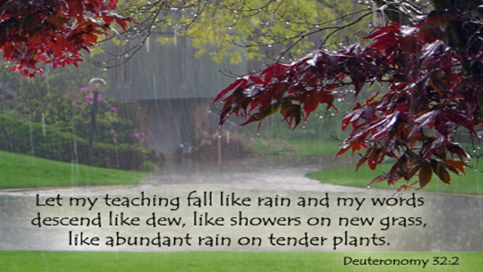
ON THE THIRD DAY HE WILL RAISE US UP
HOW TO RETURN?
“So they said, “The God of the Hebrews has met with us. Please, let us go three days’ journey into the desert and sacrifice to the Lord our God, lest He fall upon us with pestilence or with the sword.” Exodus 5:3
HOW TO RETURN TO OUR LORD? Hosea 6: 1-3
“Come, and 1/ let us return to the Lord; For 2. He has torn, but He will heal us; 3. He has stricken, but He will bind us up.
2 After two days He will revive us; On the third day He will raise us up, that we may live in His sight.
3 Let us know, Let us pursue the knowledge of the Lord. His going forth is established as the morning; He will come to us
like the 1. rain, Like 2. the latter and 3. former rain to the earth.

Slide 42
LET US RETURN UNTO THE LORD
IN THE THIRD DAY
“1. Come, and LET US RETURN UNTO THE LORD : for he hath torn, and he will heal us ; he hath smitten, and he will bind us up.
2. After two days will HE revive us: in the third day He will raise us up, and we shall live in his sight.
3. Then shall we know, if we follow on to know the Lord: his going forth 1/ is prepared as the morning; and 2/ he shall come unto us as the rain, as 3/ the latter and former rain unto the earth. Hosea 6:1-3

Slide 43
I MUST JOURNEY TODAY, TOMORROW,
AND THE DAY FOLLOWING
“Jesus Christ is the same yesterday, today, and forever.” Hebrews 13:8
Luke 13:32, 33 ““And He said to them, “Go, tell that fox, ‘Behold, I cast out demons and perform cures today and tomorrow, and the third day I shall be perfected.’ Nevertheless I must journey today, tomorrow, and the day following; for it cannot be that a prophet should perish outside of Jerusalem.”
Luke 13:32, 33

Slide 44
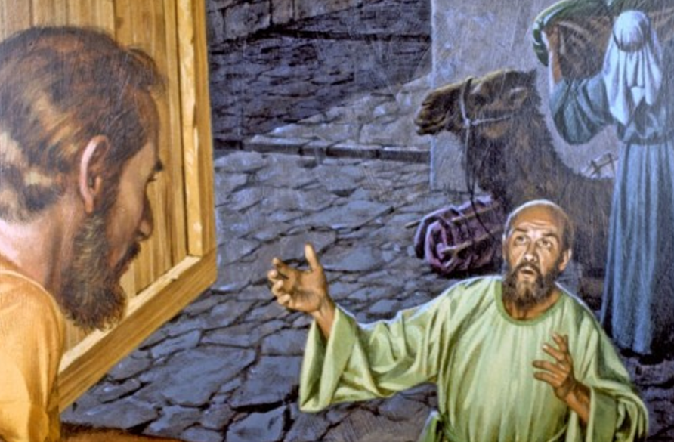
THREE MAIN IMPORTANT STEPS OF OUR SPIRITUAL TRANSFORMATION THROUGH THE HOLY SPIRIT
3/LEAVEN IN THREE MEASURES OF MEAL
“Another parable spake he unto them; The kingdom of heaven is like unto leaven, which a woman took, and hid in three measures of meal, till the whole was leavened.” MATTHEW 13:33
2/ LEND ME THREE LOAVES
“And he said unto them, Which of you shall have a friend, and shall go unto him at midnight, and say unto him, Friend, lend me three loaves;” LUKE 11:5
1/ FIRST THE BLADE, THEN THE EAR AND THE FULL CORN
For the earth bring forth fruit of herself; first the blade, then the ear, after that the full corn in the ear. Mark 4:28

Slide 45
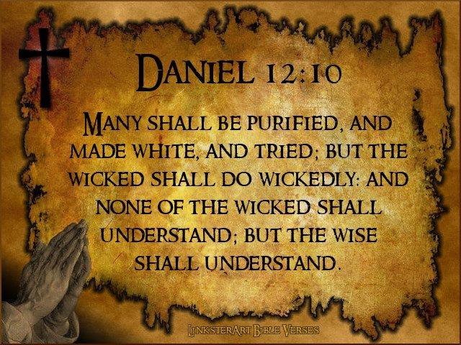
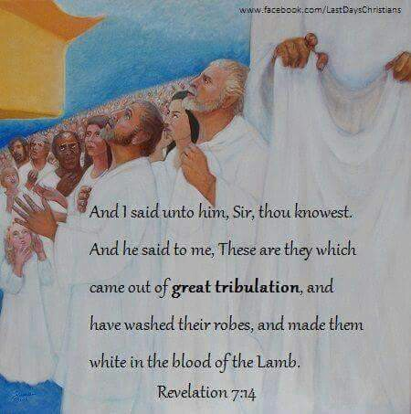
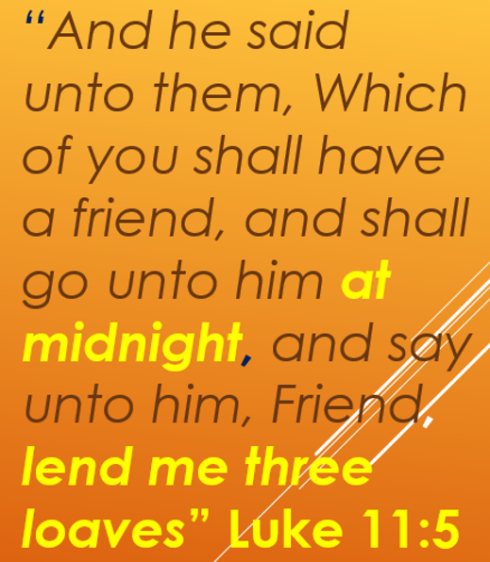
THERE ARE THREE - JOHN 5:6-8
6 This is he that came by water and blood, even Jesus Christ; not by water only, but by water and blood. And it is the Spirit that beared witness, because the Spirit is truth.
7 For there are three that bear record in heaven, the Father, the Word, and the Holy Ghost: and these three are one.
8 And there are three that bear witness in earth, the Spirit, and the water, and the blood: and these three agree in one. 9 If we receive the witness of men, the witness of God is greater: for this is the witness of God which he hath testified of his Son. 1
THREE MAIN STAGES OF EXPERIENCES
“Another parable spake he unto them; The kingdom of heaven is like unto leaven, which a woman took, and hid in three measures of meal, till the whole was leavened.” MATTHEW 13:33

Slide 46
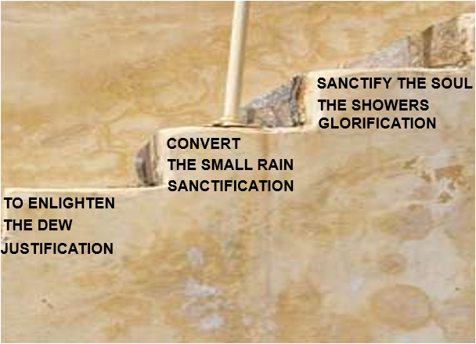
“ENLIGHTEN” STAGES OF SPIRITUAL GROWTH”
THE HOLY SPIRIT, SENT TO
ENLIGHTEN, CONVERT, AND SANCTIFY THE SOUL
The Holy Spirit, sent to 1/ enlighten, 2/ convert, and 3/ sanctify the soul. God would give all gifts in one; therefore He sent the Holy Spirit. Then why should not we expect the fulfilment of this promise, “These signs shall follow them that believe”? Why do we not look for the gift of God in its fullness? {5MR 336.1}

Slide 47
THE PILGRIM'S PROGRESS
FROM THIS WORLD TO THAT WHICH IS TO COME
BY JOHN BUNYAN
A map of the places Pilgrim travels through on his progress; a fold-out map from an edition printed in England in 1778
City of Destruction, Christian's home, representative of the world (cf. Isaiah 19:18)
Slough of Despond, the miry swamp on the way to the Wicket Gate; one of the hazards of the journey to the Celestial City. In the First Part, Christian falling into it, sank further under the weight of his sins (his burden) and his sense of their guilt.
Mount Sinai, a frightening mountain near the Village of Morality that threatens all who would go there.
Wicket Gate, the entry point of the straight and narrow way to the Celestial City. Pilgrims are required to enter by way of the Wicket Gate. Beelzebub's castle was built not very far from the Gate.
House of the Interpreter, a type of spiritual museum to guide the pilgrims to the Celestial City, emblematic of Calvary and the tomb of Christ.
Hill Difficulty, both the hill and the road up is called "Difficulty"; it is flanked by two treacherous byways "Danger" and "Destruction." There are three choices: Christian takes "Difficulty" (the right way), and Formalist and Hypocrisy take the two other ways, which prove to be fatal dead ends.
House Beautiful, a palace that serves as a rest stop for pilgrims to the Celestial City. It apparently sits atop the Hill Difficulty. From the House Beautiful one can see forward to the Delectable Mountains. It represents the Christian congregation, and Bunyan takes its name from a gate of the Jerusalem temple (Acts 3:2, 10).
Valley of Humiliation, the Valley on the other side of the Hill Difficulty, going down into which is said to be extremely slippery by the House Beautiful's damsel Prudence. It is where Christian, protected by God's Armor, meets Apollyon and they had that dreadful, long fight where Christian was victorious over his enemy by impaling Apollyon on his Sword of the Spirit (Word of God) which caused the Foul Fiend to fly away. Apollyon met Christian in the place known as "Forgetful Green." This Valley had been a delight to the "Lord of the Hill", Jesus Christ, in his "state of humiliation."
Valley of the Shadow of Death, a treacherous, devilish Valley filled with demons, dragons, fiends, satyrs, goblins, hobgoblins, monsters, creatures from the bottomless pit, beasts from the mouth of Hell, darkness, terror, and horror with a Slough of Despond, bog on one side and a deep chasm/ditch on the other side of the King's Highway going through it (cf. Psalm 23:4).
Gaius' Inn, a rest stop in the Second Part of the Pilgrim's Progress.
Vanity Fair, a city through which the King's Highway passes and the yearlong Fair that is held there.
Plain Ease, a pleasant area traversed by the pilgrims.
Hill Lucre, location of a reputed silver mine that proves to be the place where By-Ends and his companions are lost.
The Pillar of Salt, which was Lot's wife, who was turned into a pillar of salt when Sodom and Gomorrah were destroyed. The pilgrim's note that its location near the Hill Lucre is a fitting warning to those who are tempted by Demas to go into the Lucre silver mine.
River of God or River of the Water of Life, a place of solace for the pilgrims. It flows through a meadow, green all year long and filled with lush fruit trees. In the Second Part the Good Shepherd is found there to whom Christiana's grandchildren are entrusted.
By-Path Meadow, the place leading to the grounds of Doubting Castle.
Doubting Castle, the home of Giant Despair and his Giantess wife, Diffidence; only one key could open its doors and gates, the key Promise.
The Delectable Mountains, known as "Immanuel's Land." Lush country from whose heights one can see many delights and curiosities. It is inhabited by sheep and their shepherds, and from Mount Clear one can see the Celestial City.
The Enchanted Ground, an area through which the King's Highway passes that has air that makes pilgrims want to stop to sleep. If one goes to sleep in this place, one never wakes up. The shepherds of the Delectable Mountains warn pilgrims about this.
The Land of Beulah, a lush garden area just this side of the River of Death.
The River of Death, the dreadful river that surrounds Mount Zion, deeper or shallower depending on the faith of the one traversing it.
The Celestial City, the "Desired Country" of pilgrims, heaven, the dwelling place of the "Lord of the Hill", God. It is situated on Mount Zion.
WILL CONTINUE

Slide 48
METHODS OF WORK BY THE HOLY SPIRIT
INDIVIDUAL WORK OF THE HOLY SPIRIT
“The Holy Spirit seeks to abide in each soul. If it is welcomed as an honoured guest, those who receive it will be made complete in Christ. The good work begun will be finished; 1.THE HOLY THOUGHTS, 2.HEAVENLY AFFECTIONS, and
1. CHRISTLIKE ACTIONS will take the place 1.Of impure thoughts, 2.perverse sentiments, and 3. rebellious acts. Counsels on Health, 561 (1896). {LDE 187.2}
HOLY SPIRIT GUIDES MANY MEMBERS OF THE GOD”S CHURCH TO GROW IN CHRIST
“The convocations of the church, as in camp meetings, the assemblies of the home church, and all occasions where there is personal labour for souls, are God’s appointed opportunities for giving the early and the latter rain. Testimonies to Ministers and Gospel Workers, 508 (1897). {LDE 188.1}
“When the way is prepared for the Spirit of God, the blessing will come. Satan can no more hinder a shower of blessing from descending upon God’s people than he can close the windows of heaven that rain cannot come upon the earth.”
Selected Messages 1:124 (1887). {LDE 188.2}

Slide 49
METHODS OF WORK BY THE HOLY SPIRIT
OUR PETITIONS FOR RECEIVING
THE HOLY SPIRIT!
“We are not willing enough to trouble the Lord with our petitions, and to ask Him for the gift of the Holy Spirit. The Lord wants us to trouble Him in this matter. He wants us to press our petitions to the throne.” 537 (1909). {LDE 188.6}
THE MEASURE OF THE HOLY SPIRIT
“We may have had a measure of the Spirit of God, but by prayer and faith we are continually to seek more of the Spirit. It will never do to cease our efforts. If we do not progress, if we do not place ourselves in an attitude to receive both the former and the latter rain, we shall lose our souls, and the responsibility will lie at our own door..” {LDE 187.3}
DO NOT FORGET IT
“The measure of the Holy Spirit we receive will be proportioned to the measure of our desire and the faith exercised for it, and the use we shall make of the light and knowledge that shall be given to us.”{LDE 188.5}

Slide 50
METHODS OF WORK BY THE HOLY SPIRIT
OUR PETITIONS FOR RECEIVING
THE HOLY SPIRIT!
“We are not willing enough to trouble the Lord with our petitions, and to ask Him for the gift of the Holy Spirit. The Lord wants us to trouble Him in this matter. He wants us to press our petitions to the throne.” 537 (1909). {LDE 188.6}
THE MEASURE OF THE HOLY SPIRIT
“We may have had a measure of the Spirit of God, but by prayer and faith we are continually to seek more of the Spirit. It will never do to cease our efforts. If we do not progress, if we do not place ourselves in an attitude to receive both the former and the latter rain, we shall lose our souls, and the responsibility will lie at our own door..” {LDE 187.3}
DO NOT FORGET IT
“The measure of the Holy Spirit we receive will be proportioned to the measure of our desire and the faith exercised for it, and the use we shall make of the light and knowledge that shall be given to us.”{LDE 188.5}

Slide 51
IMPORTANT WARNINGS
ARE WE WAITING GOD TO OUTPOUR THE HOLY SPIRIT OR HE IS WAITING US?
WE NEED MORE TODAY
WHO WILL APPRECIATE THE EARLY RAIN
“We may be sure that when the Holy Spirit is poured out, those who did not receive and appreciate the early rain will not see or understand the value of the latter rain.” {5MR 337.1}
“We should pray as earnestly for the descent of the Holy Spirit as the disciples prayed on the Day of Pentecost. IF THEY NEEDED IT AT THAT TIME, WE NEED IT MORE TODAY.” {LDE 188.3}
HEAVEN IS WAITING TO BESTOW IT
THE MEASURE OF THE HOLY SPIRIT
“The measure of the Holy Spirit we receive will be proportioned to the measure of our desire and the faith exercised for it, and the use we shall make of the light and knowledge that shall be given to us.” {LDE 188.5}
The descent of the Holy Spirit upon the church is looked forward to as in the future, but it is the privilege of the church to have it now. Seek for it, pray for it and believe for it. We must have it, and Heaven is waiting to bestow it.”{LDE 188.4}

Slide 52
God leads His people on, step by step. He brings them up to different points calculated to manifest what is in the heart. Some endure at one point, but fall off at the next. At every advanced point the heart is tested and tried a little closer ……Those who come up to every point, and stand every test, and overcome, be the price what it may, have heeded the counsel of the True Witness, and they will receive the latter rain, and thus be fitted for translation. {LHU 375.2}
GOD LEADS HIS PEOPLE ON,
STEP BY STEP
“The work that God has begun in the human heart in giving His light and knowledge must be continually going forward. {TM 507.1}”

Slide 53
FIRST ANGEL MESSAGE Then I saw another angel flying in the midst of heaven, having the everlasting gospel to preach to those who dwell on the earth to every nation, tribe, tongue, and people ⁷ saying with a loud voice, “1.Fear God and 2.give glory to Him, for the hour of His judgment has come; and 3.worship Him who made heaven and earth, the sea and springs of water.” REVELATION 14:6-7
REPETITION OF THE SECOND ANGEL MESSAGE
After these things I saw another angel coming down from heaven, having great authority, and the earth was illuminated with his glory. ² And he cried mightily with a loud voice, saying, 1. “Babylon the great is fallen, is fallen, and 2. has become a dwelling place of demons, 3. a prison for every foul spirit, and 4. a cage for every unclean and hated bird! ³ For 5. all the nations have drunk of the wine of the wrath of her fornication, 6. the kings of the earth have committed fornication with her, and 7.the merchants of the earth have become rich through the abundance of her luxury.” REVELATION 18:1-3
LAST ANGELS MESSAGES OF WORNING‘S
THEN A THIRD ANGEL followed them, saying with a loud voice, “1. If anyone worships the beast and his image and 2. receives his mark on his forehead or on his hand, ^{10.} 3. he himself shall also drink of the wine of the wrath of God, which is poured out full strength into the cup of His indignation. 4. He shall be tormented with fire and brimstone in the presence of the holy angels and in the presence of the Lamb. ¹¹ And the smoke of their torment ascends forever and ever; and they have no rest day or night, 5. who worship the beast and 6. his image, and 7. whoever receives the mark of his name.” REVELATION 14:9-11
^{‘SECOND ANGEL} MESSAGE
And another angel followed, saying, “1.Babylon is fallen, is fallen, that great city, 2.because she has made all nations drink of the wine 3.of the wrath of her fornication.”
REVELATION 14: 8ANGE

Slide 54
THE PILGRIM'S PROGRESS
FROM THIS WORLD TO THAT WHICH IS TO COME
BY JOHN BUNYAN
A map of the places Pilgrim travels through on his progress; a fold-out map from an edition printed in England in 1778
City of Destruction, Christian's home, representative of the world (cf. Isaiah 19:18)
Slough of Despond, the miry swamp on the way to the Wicket Gate; one of the hazards of the journey to the Celestial City. In the First Part, Christian falling into it, sank further under the weight of his sins (his burden) and his sense of their guilt.
Mount Sinai, a frightening mountain near the Village of Morality that threatens all who would go there.
Wicket Gate, the entry point of the straight and narrow way to the Celestial City. Pilgrims are required to enter by way of the Wicket Gate. Beelzebub's castle was built not very far from the Gate.
House of the Interpreter, a type of spiritual museum to guide the pilgrims to the Celestial City, emblematic of Calvary and the tomb of Christ.
Hill Difficulty, both the hill and the road up is called "Difficulty"; it is flanked by two treacherous byways "Danger" and "Destruction." There are three choices: Christian takes "Difficulty" (the right way), and Formalist and Hypocrisy take the two other ways, which prove to be fatal dead ends.
House Beautiful, a palace that serves as a rest stop for pilgrims to the Celestial City. It apparently sits atop the Hill Difficulty. From the House Beautiful one can see forward to the Delectable Mountains. It represents the Christian congregation, and Bunyan takes its name from a gate of the Jerusalem temple (Acts 3:2, 10).
Valley of Humiliation, the Valley on the other side of the Hill Difficulty, going down into which is said to be extremely slippery by the House Beautiful's damsel Prudence. It is where Christian, protected by God's Armor, meets Apollyon and they had that dreadful, long fight where Christian was victorious over his enemy by impaling Apollyon on his Sword of the Spirit (Word of God) which caused the Foul Fiend to fly away. Apollyon met Christian in the place known as "Forgetful Green." This Valley had been a delight to the "Lord of the Hill", Jesus Christ, in his "state of humiliation."
Valley of the Shadow of Death, a treacherous, devilish Valley filled with demons, dragons, fiends, satyrs, goblins, hobgoblins, monsters, creatures from the bottomless pit, beasts from the mouth of Hell, darkness, terror, and horror with a Slough of Despond, bog on one side and a deep chasm/ditch on the other side of the King's Highway going through it (cf. Psalm 23:4).
Gaius' Inn, a rest stop in the Second Part of the Pilgrim's Progress.
Vanity Fair, a city through which the King's Highway passes and the yearlong Fair that is held there.
Plain Ease, a pleasant area traversed by the pilgrims.
Hill Lucre, location of a reputed silver mine that proves to be the place where By-Ends and his companions are lost.
The Pillar of Salt, which was Lot's wife, who was turned into a pillar of salt when Sodom and Gomorrah were destroyed. The pilgrim's note that its location near the Hill Lucre is a fitting warning to those who are tempted by Demas to go into the Lucre silver mine.
River of God or River of the Water of Life, a place of solace for the pilgrims. It flows through a meadow, green all year long and filled with lush fruit trees. In the Second Part the Good Shepherd is found there to whom Christiana's grandchildren are entrusted.
By-Path Meadow, the place leading to the grounds of Doubting Castle.
Doubting Castle, the home of Giant Despair and his Giantess wife, Diffidence; only one key could open its doors and gates, the key Promise.
The Delectable Mountains, known as "Immanuel's Land." Lush country from whose heights one can see many delights and curiosities. It is inhabited by sheep and their shepherds, and from Mount Clear one can see the Celestial City.
The Enchanted Ground, an area through which the King's Highway passes that has air that makes pilgrims want to stop to sleep. If one goes to sleep in this place, one never wakes up. The shepherds of the Delectable Mountains warn pilgrims about this.
The Land of Beulah, a lush garden area just this side of the River of Death.
The River of Death, the dreadful river that surrounds Mount Zion, deeper or shallower depending on the faith of the one traversing it.
The Celestial City, the "Desired Country" of pilgrims, heaven, the dwelling place of the "Lord of the Hill", God. It is situated on Mount Zion.
WILL CONTINUE

Slide 55
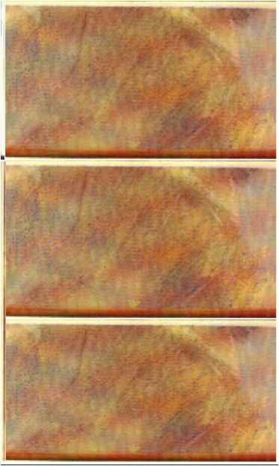
EXPERIENCE WITH THE HOLY SPIRIT IN THE PROCLAMATIONS
OF THE THREE ANGELS MESSAGES
ANGEL OF REVELATION 18
REVELATION 18: 4-8
LATTER RAIN
AS THE SHOWERS
LOYD CRY
GLORIFICATION
THE FALL OF BABYLON
THE GREAT
THIRD ANGELS MESSAGE
REVELATION 14: 9 -12
EARLY RAIN LATTER RAIN
SANCTIFICATION
CRIED MIGHTILY
WITH A LOUD VOICE
SECOND ANGELS MESSAGE
A LOUD VOICE
“AFTER THESE THINGS I SAW ANOTHER ANGEL COMING DOWN FROM HEAVEN, HAVING GREAT AUTHORITY, AND THE EARTH WAS ILLUMINATED WITH HIS GLORY. ² AND HE CRIED MIGHTILY WITH A LOUD VOICE”
REVELATION 14:8
“HERE IS THE PATIENCE OF THE SAINTS; HERE ARE THOSE WHO KEEP THE COMMANDMENTS OF GOD AND THE FAITH OF JESUS.”
EARLY (FORMER) RAIN
THE SMALL RAIN
MIDNIGHT CRY
JUSTIFICATION
FIRST ANGELS MESSAGE
REVELATION. 14:6-7
HOLY SPIRIT AS
DEW AND RAIN
“BABYLON THE GREAT IS FALLEN, IS FALLEN, AND HAS BECOME A DWELLING PLACE OF DEMONS, A PRISON FOR EVERY FOUL SPIRIT, AND A CAGE FOR EVERY UNCLEAN AND HATED BIRD! ...”
BABYLON IS FALLEN
“A LOUD VOICE, “IF ANYONE WORSHIPS THE BEAST AND HIS IMAGE, AND RECEIVES HIS MARK ON HIS FOREHEAD OR ON HIS HAND, ¹⁰ HE HIMSELF SHALL ALSO DRINK OF THE WINE OF THE WRATH OF GOD,”
JUSTIFICATION
“ALL NATIONS DRINK OF THE WINE OF THE WRATH OF HER FORNICATION.”
“HAVING
THE EVERLASTING GOSPEL”
“FEAR GOD
AND GIVE GLORY TO HIM

Slide 56
REVIVAL OF THRUE GODLINESS
AMONG US

Slide 57
LET'S US MAKE OUR CHOUCE
TO BECOME SANCTIFIED,
REFINED, AND ENNOBLED
THEY HAVE NOT ADVANCED STEP BY STEP
“Under the Holy Spirit’s working even the weakest, by exercising faith in God, learned to improve their entrusted powers and to become 1. sanctified, 2. refined, and 3. ennobled. As in humility they submitted to the moulding influence of the Holy Spirit, they received of the fullness of the Godhead and were fashioned in the likeness of the divine.” {AA 49.3}
“There are some of our ministers who are engaged in active service who have some sense of the importance of the work, but there is a large number who are handling sacred truth about as they would engage in any common business. THEY HAVE NOT BEEN REFINED, ENNOBLED, SANCTIFIED, BY THE TRUTH.. They have not real, genuine faith in taking God at THEY HAVE NOT ADVANCED STEP BY STEP, GROWING IN GRACE AND THE KNOWLEDGE OF JESUS CHRIST. His word. THEY HAVE NOT GONE ON FROM STRENGTH TO A GREATER STRENGTH. They have not increased in ability, but kept up the same low tone of efficiency. They have not become able men in the Scriptures, mighty men in God, and yet every privilege has been within their reach. The cause of God has not been glorified by their tame, Spiritless, Christless work. {17MR 142.2}
These have done great injury to the truth, and why? Because the heart is not cleansed. They have not a new, clean heart, but a heart that is open to the temptations of Satan. Such can never lead the people to the true, pure fountain of living waters. They may make others acquainted with the reasons of our faith, but it will be impossible for them to do the work which a true shepherd of the flock will do—to “feed the flock of God, ... not by constraint, but willingly; not for filthy lucre, but of a ready mind; neither as being lords over God’s heritage, but being ensamples to the flock”
[1 Peter 5:2-5; and verses 4-10 quoted]. {17MR 142.3}

Slide 58
LET'S US MAKE OUR CHOUCE
TO BECOME SANCTIFIED,
REFINED, AND ENNOBLED
THEY HAVE NOT ADVANCED STEP BY STEP
“Under the Holy Spirit’s working even the weakest, by exercising faith in God, learned to improve their entrusted powers and to become 1. sanctified, 2. refined, and 3. ennobled. As in humility they submitted to the moulding influence of the Holy Spirit, they received of the fullness of the Godhead and were fashioned in the likeness of the divine.” {AA 49.3}
“There are some of our ministers who are engaged in active service who have some sense of the importance of the work, but there is a large number who are handling sacred truth about as they would engage in any common business. THEY HAVE NOT BEEN REFINED, ENNOBLED, SANCTIFIED, BY THE TRUTH.. They have not real, genuine faith in taking God at THEY HAVE NOT ADVANCED STEP BY STEP, GROWING IN GRACE AND THE KNOWLEDGE OF JESUS CHRIST. His word. THEY HAVE NOT GONE ON FROM STRENGTH TO A GREATER STRENGTH. They have not increased in ability, but kept up the same low tone of efficiency. They have not become able men in the Scriptures, mighty men in God, and yet every privilege has been within their reach. The cause of God has not been glorified by their tame, Spiritless, Christless work. {17MR 142.2}
These have done great injury to the truth, and why? Because the heart is not cleansed. They have not a new, clean heart, but a heart that is open to the temptations of Satan. Such can never lead the people to the true, pure fountain of living waters. They may make others acquainted with the reasons of our faith, but it will be impossible for them to do the work which a true shepherd of the flock will do—to “feed the flock of God, ... not by constraint, but willingly; not for filthy lucre, but of a ready mind; neither as being lords over God’s heritage, but being ensamples to the flock”
[1 Peter 5:2-5; and verses 4-10 quoted]. {17MR 142.3}

Slide 59
COLD
“ENLIGHTEN” STAGE OF SPIRITUAL GROWTH”
NOW WE WANT TO MAKE OUR CHOICE
LUKEWARM
HOT
THEY ARE VESSELS
TO DISHONOUR
THEY ARE VESSELS
TO DISHONOUR
THEY ACKNOWLEDGE
THEIR POOR SPIRITUAL CONDITION
AND THEY ARE WILING TO BECOME HOT
THEY ARE VESSELS
TO HONOUR
THEY ARE FIT
FOR THE MASTER’S USE
THEY ARE LIKE JUDAS
THEY ARE NOMINAL ADVENTIST WHO
ARE SELF SUFFICIENT
“* Shall we now have that faith that works by love and purifies the soul here where this reformation means so much?
* Well, that is what we want; because the latter rain is coming, and we want the vessel all cleansed from its work of impurity. We want the vessel to be a vessel unto honour, fit for the Master’s use. There are vessels to dishonour, and there are vessels to honour.
Now we want to make our choice, and reveal we choose to be a vessel unto honour.” {1SAT 197.2}

Slide 60
OLD TESTAMENT
CEREMONIAL STAGES
OF SPIRITUAL GROWING
7- VICTORY
ATTAIN UNTO THE
RESURRECTION OF THE DEAD
3
6- REDEMTION
VICTORY
CONFORMABLE UNTO HIS DEATH
5 - SANCTIFICATION
THE FELLOWSHIP OF HIS SUFFERINGS
2
4 - RECONCILIATION
- RESURRECTION
SANCTIFICATION
3 - JASTIFICATION -
I MAY KNOW HIM
1
JASTIFICATION
2 – CLEANING -
RIGHTEOUSNESS
1 – FORGIVNESS - (REMISSION)
THE FAITH OF CHRIST

Slide 68
YOUR ONLY HOPE IS TO PLACE YOURSELF
IN THE CHANNEL OF LIGHT
“I cannot forbear telling you that you are as a piece of machinery that has been put out of order by an erroneous course of development and discipline. Your only hope is to place yourself in the channel of light shining from the Sun of Righteousness, closing every avenue that encourages wrong tendencies in the development of character. You need to remove from the [mind] scenes which have been as a training school to destroy your confidence in almost every one. No longer choose the malarias atmosphere you have hitherto lived in. You need to become a Christian in word, thought, and action. You need to be converted. The Holy Spirit alone can renovate and transform you. This Spirit alone can keep you from making your mind and heart a vineyard that Satan will cultivate. As soon as possible you should place yourself as a little child at the feet of Jesus, that you may receive the Holy Spirit’s moulding. Then your mental faculties will be invigorated and will bear taxing in the right lines.” {Lt29-1897.6}

Slide 70
118

